Slide 1
Module 2: Overview of Performance Expectations
Notes:
Slide 70

Slide 2
Module 2: Overview of Performance Expectations
What are the component parts of a “performance expectation”?
What are the implications of the three dimensions in the “performance expectations” for learning in the science classroom?
Notes:
Slide 71

Slide 3
What Are Performance Expectations?
Performance Expectations state what students should be able to do in order to demonstrate that they have met the standard, thus providing clear and specific targets for curriculum, instruction, and classroom assessment.
Notes:
Slide 72

Slide 4
Performance Expectations Build Across Years
9-12
HS-PS1-1. Use the periodic table as a model to predict the relative properties of elements based on the patterns of electrons in the outermost energy level of atoms.
6-8
MS-PS1-2. Analyze and interpret data on the properties of substances before and after the substances interact to determine if a chemical reaction has occurred.
3-5
5-PS1-3. Make observations and measurements to identify materials based on their properties.
2-PS1-2. Analyze data obtained from testing different materials to determine which materials have the properties that are best suited for an intended purpose
Modified from Brian Reiser
Notes:
Slide 73

Slide 5
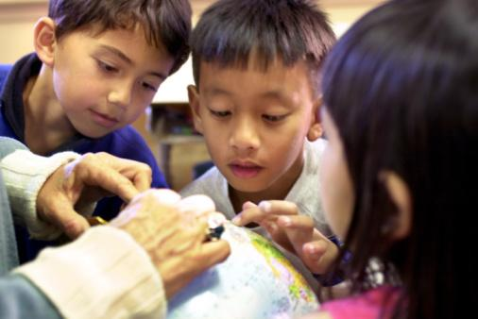
Who Should Meet Performance Expectations?
Notes:
Slide 74

Slide 6
How Are Performance Expectations Structured?
Performance Expectation
Science & Engineering Practices | Disciplinary Core Ideas | Crosscutting Concepts
Connections to Other science disciplines at this grade level Other DCIs for older and younger students Common Core State Standards in Mathematics and Language Arts
Notes:
Slide 75

Slide 7
Reading a Performance Expectation
Notes:
Slide 76

Slide 8
Instruction Builds Toward Performance
Notes:
Slide 77

Slide 9
Module 2 Reflection
What are the component parts of a “performance expectation”?
What are the implications of the three dimensions in the “performance expectations” for learning in the science classroom?
Notes:
Slide 78

