Slide 2
What is Three-Dimensional Learning?
Three-dimensional learning shifts the focus of the science classroom to environments where students use core ideas, crosscutting concepts with scientific practices to explore, examine, and use science ideas to explain how and why phenomena occur or to design solutions to problems.

Slide 3
“Learning About” or “Figuring Out”
Explanatory ideas are important so that students are figuring out phenomena and not just learning about facts and details.
Science and engineering practices build explanatory ideas.

Slide 4
Student Hat --- Teacher Hat

Slide 5
Designing NGSS Units

Slide 6
APhenomena: Optical Illusions

Slide 8
Notes:
https://youtu.be/Ea9kU1eSuW8?t=37s

Slide 9
Notes:
https://www.youtube.com/v/gfvMU36fgKw

Slide 10
Optical illusions: how do these images work?
With your table, develop your own questions that will drive our quest to figure out these optical illusions. Place these Qs on a post it and place on one of our 3 Driving Question Boards.
What are some questions you have about the optical illusions, eyes, vision, and how we see?

Slide 11
Driving Question: Can I trust my eyes?
Lesson level question:
What do you need in order to see an object?

Slide 12
Light Box 1: Create this data table
Data
 | Observation
First: Lid Closed and Flap Closed
Second: Lid Closed and Flap Open

Slide 13
How can I see an object?
Look into the shoebox with the flap CLOSED.
Think about:
How does that help you understand how you can see the object?

Slide 14
How can I see an object?
Look into the shoebox with the flap OPEN.
Think about:
How does that help you understand how you can see the object?

Slide 15
Light Box 1
Data
 | Observation
First: Lid Closed and Flap Closed
Second: Lid Closed and Flap Open
Making Sense
Leverage Patterns: How were your 2 observations different?

Slide 16
Light Box 2
Add the divider to your light box. Keep the box lid closed and the slide flap open.
Draw what you see and include as much detail as you can.

Slide 17
Create a MODEL to help explain how we saw what we did in the 3 stages of the light box
Include:
Components (relevant parts)
Relationships (how the components interact)
What moves? What changes?
Connections (to big science ideas, processes, theories, or laws)

Slide 18
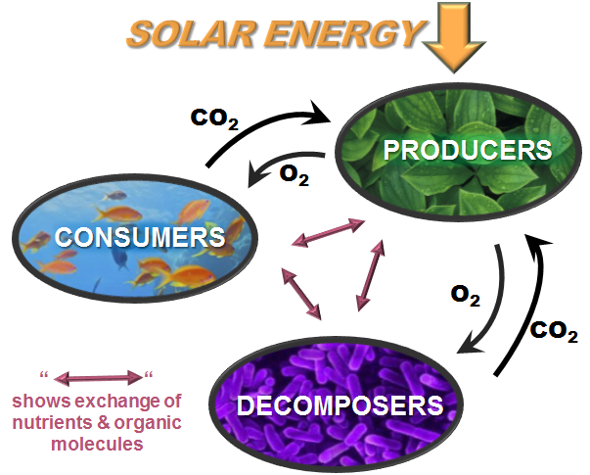
Crosscutting Concept: System and System Models
Models
Components
Relationships
Energy and Matter flows
Inputs
Flow
Output

Slide 19
Create a MODEL to help explain how we saw what we did in the 3 stages of the light box
Include:
Components (relevant parts)
Relationships (how the components interact)
What moves? What changes?
Connections (to big science ideas, processes, theories, or laws)

Slide 20
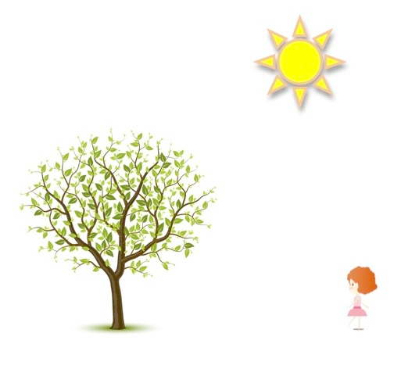
Why can the girl see the tree?

Slide 21
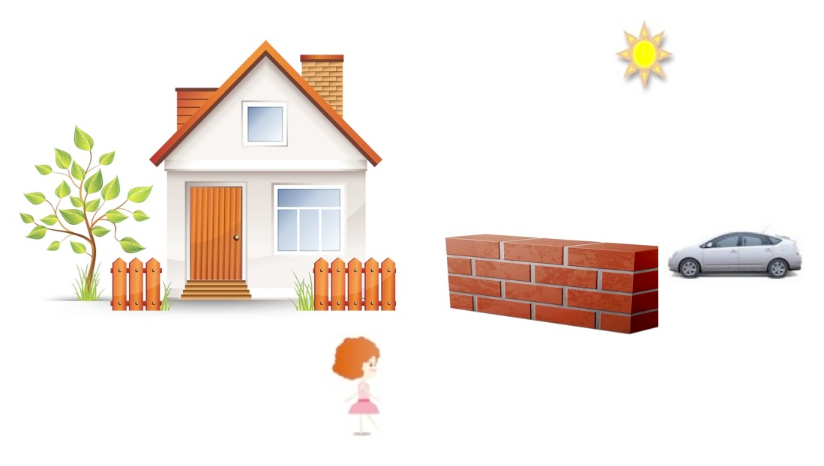
Why can’t the girl see the car?

Slide 22
Create a MODEL to help explain how we saw what we did in the 3 stages of the light box
Include:
Components (relevant parts)
Relationships (how the components interact)
What moves? What changes?
Connections (to big science ideas, processes, theories, or laws)

Slide 23
Consensus Model
At your table, share your models.
EXPLAIN the components and the relationship between the components.
Using your table talk discussion and the visible thinking of group members, create a consensus model together to explain vision. These models will become part of a gallery walk.

Slide 24
Storyline for the Unit
Goal: Making sense of phenomena
Driving Question: Can I trust my eyes?
Optical Illusions
Investigate and build knowledge through practices and CCCs
Incrementally Build Explanations, Models, or Designs
Phenomena-driven Questions
What do you need to see?
Models, PS4
Systems
Initial explanation, model or design
How does light get to our eyes?
How does light allow vision?
Models, Explain, LS1
S&F, Systems
Add to/revise
How does the brain process signals?
Models, Explain, LS1,
S&F, Systems
Add to/revise
What happens when light reaches an object?
Explanations, Models PS4
Systems, S&F
Final consensus explanation, model or design

Slide 25
Models at the beginning of the Unit

Slide 26
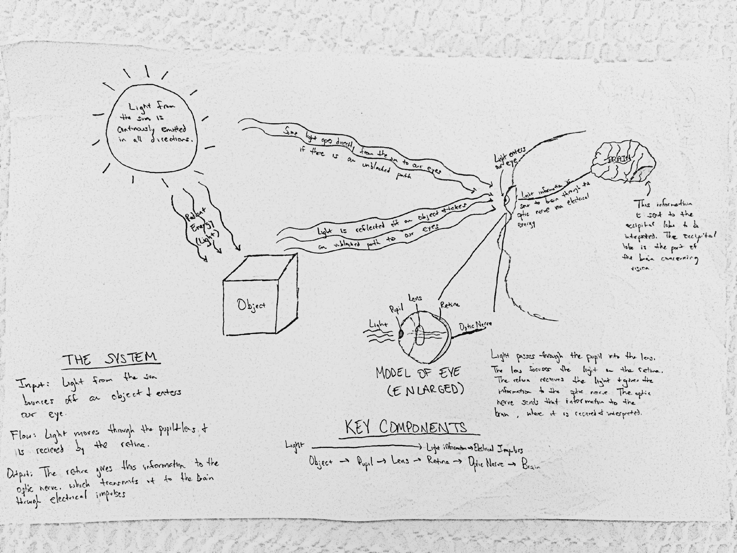
Models in the Middle of the Unit

Slide 27
When evaluating student artifacts
What does “this” artifact tell you about student understanding at the given point in the lesson?
Disciplinary Core ideas
Crosscutting Concepts
Science and Engineering Practices

Slide 28
What have we figured out?
Examine your 2 student artifacts. Using your MS-PS4 Handout, determine if the artifact(s) have evidence of student understanding of the Disciplinary Core Idea (DCI) or Crosscutting Concept (CCC) elements found on the handout.
Highlight the elements that you determine the students have communicated understanding of with their models.

Slide 29
How have students engaged in SEP’s to Figure out?
Examine your 2 student artifacts. Using your Grades 6-8 and Grades 9-12 Science and Engineering (SEP) Handouts, determine which elements of the practices can be evidenced by these student artifacts.
Highlight the elements that you determine the students have communicated understanding of with their models.

Slide 30
Table Share
Each pair should share their evidence (specific elements) of student opportunities to use each of the 3 dimensions to figure out our lesson-level phenomena.
As a group, discuss any evidence of evolving 3-dimensional understanding. (comparing model 1 to model 2).

Slide 31
Models at the beginning of the Unit

Slide 32
Models in the Middle of the Unit

Slide 33
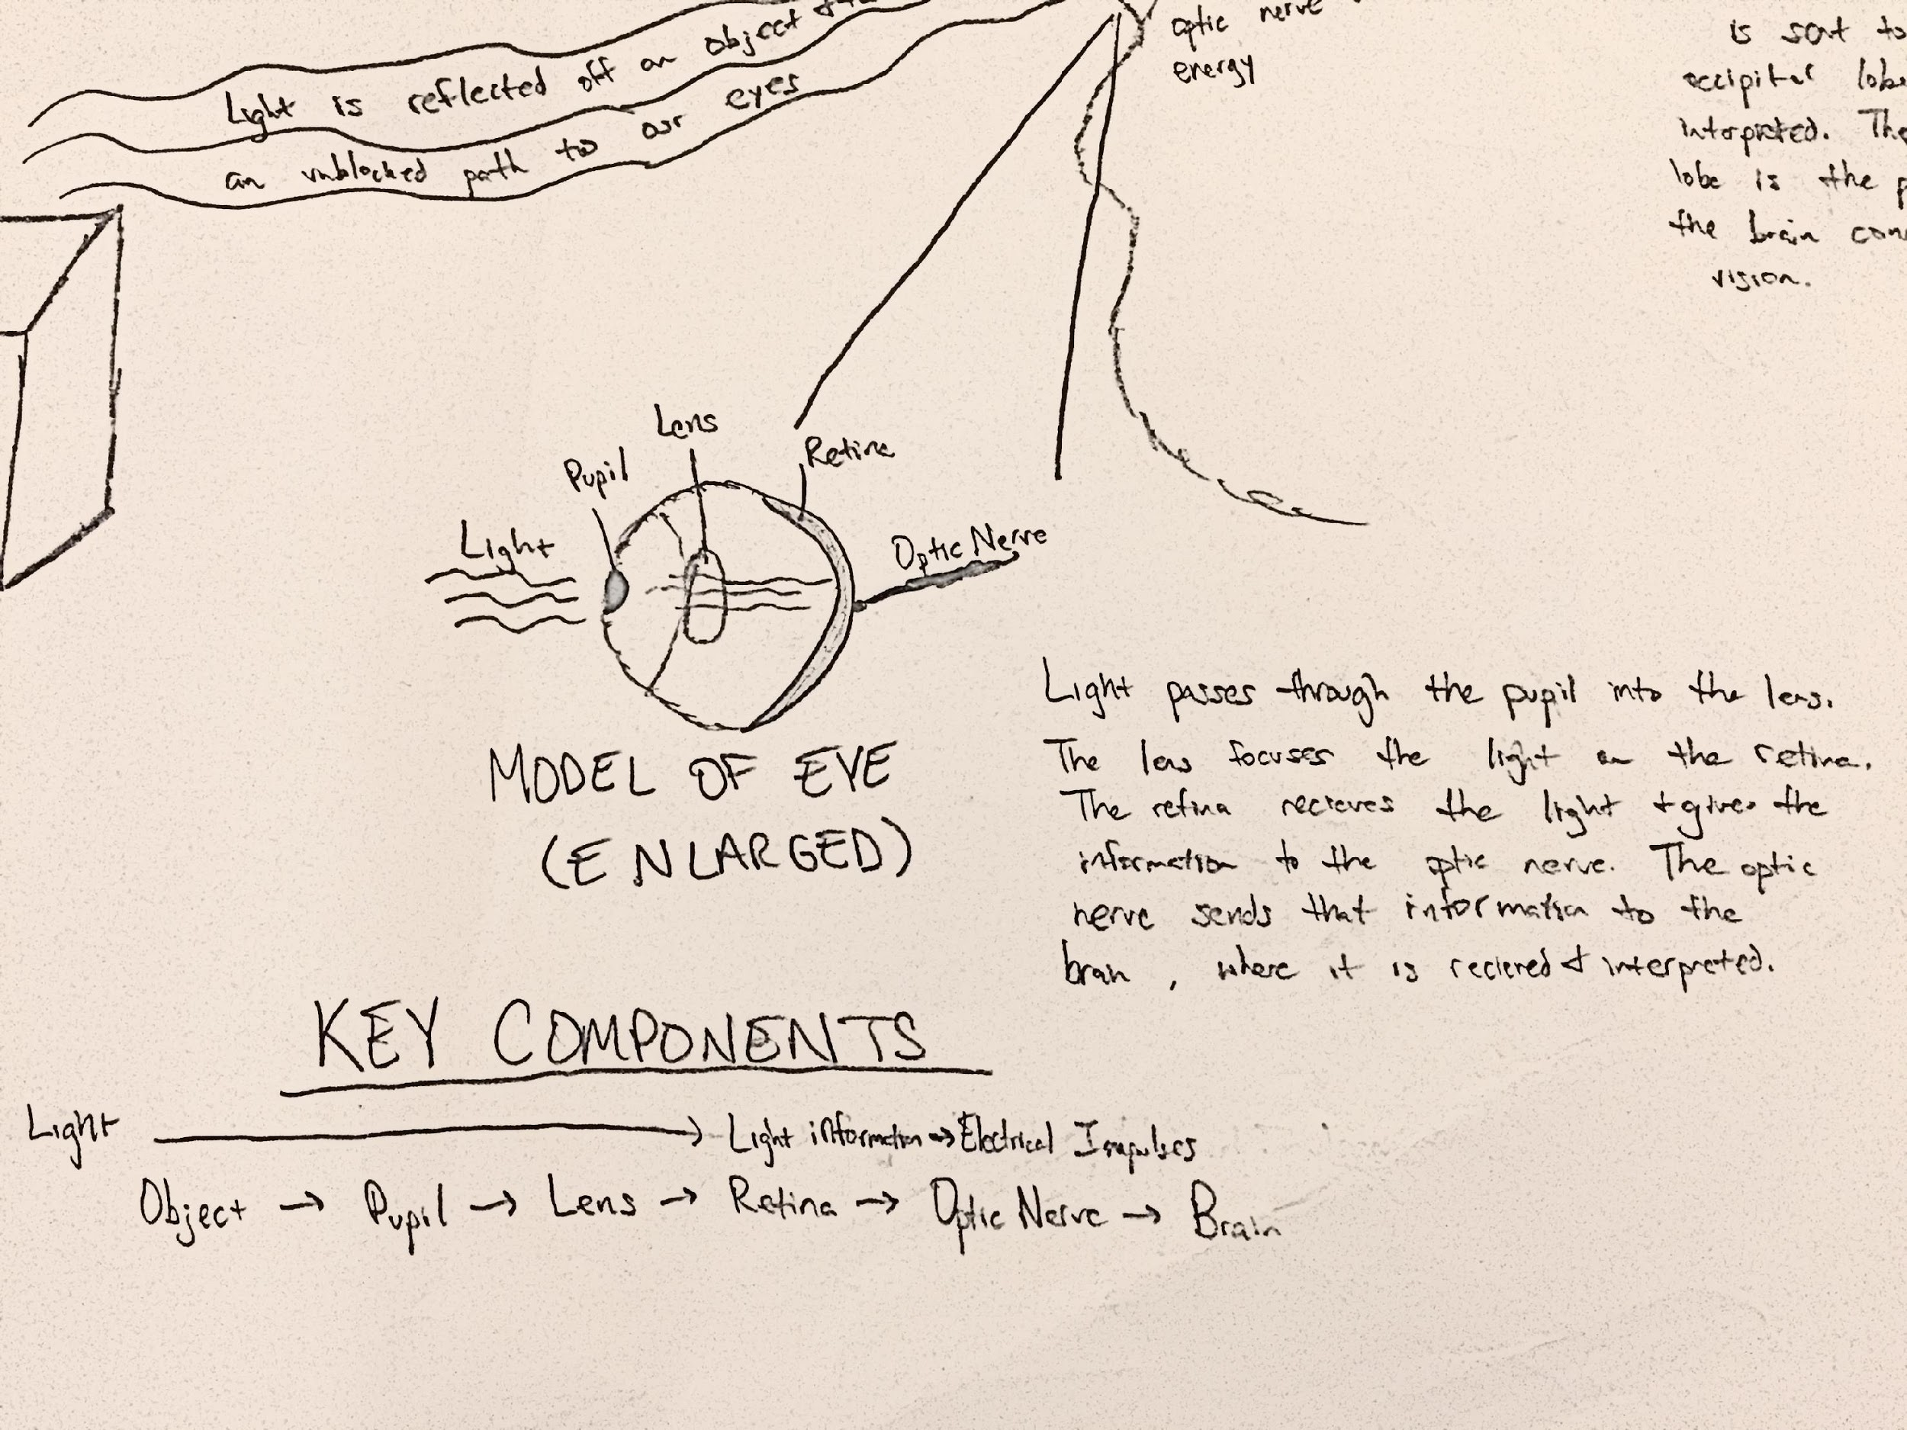
Models in the Middle of the Unit

Slide 34
Models in the Middle of the Unit

Slide 35
Models in the Middle of the Unit

Slide 36
What pieces of the puzzle are we building?
When light shines on an object, it is reflected, absorbed, or transmitted through the object, depending on the object’s material and the frequency (color) of light.
The path that light travels can be traced as straight lines. (PS4.A)
The path that light takes travels in straight lines.
There are four necessary components of vision, an eye, an object, a light source, and a straight path between the eye and the object.
Models can be used to represent systems and their interactions (inputs, outputs, flows) and energy, matter, & info flows within systems. (Appendix G, NGSS).
Light transfers energy from place to place.

Slide 37
What pieces of the puzzle are we building?
When light shines on an object, it is reflected, absorbed, or transmitted through the object, depending on the object’s material and the frequency (color) of light.
The path that light travels can be traced as straight lines. (PS4.A)
The path that light takes travels in straight lines.
There are four necessary components of vision, an eye, an object, a light source, and a straight path between the eye and the object.
Models can be used to represent systems and their interactions (inputs, outputs, flows) and energy, matter, & info flows within systems. (Appendix G, NGSS).
Light transfers energy from place to place.

Slide 38
Coherence in Lessons
What do students figure out in a lesson?
How is this related to the DCIs?

Slide 39
Can we explain how optical illusions work?

Slide 40
Students building understanding piece by piece with each lesson

Slide 41
What pieces of the puzzle are we building?
Each sense receptor responds to different inputs (electromagnetic, mechanical, chemical) transmitting them as signals that travels along nerve cells to the brain. The signals are then processed in the brain, resulting in immediate behaviors or memories.
The eye receives the light energy (electromagnetic radiation) and sends that signal via electrical impulse (energy) via the optic nerve to the brain.
Multicellular organisms are organized into levels of organization where the parts work together to accomplish a function.
The eye itself is made of numerous subparts that function together for vision.
Multicellular organisms have a hierarchical structural organization, in which any one system is made up of numerous parts and is itself a component of the next level. (LS1A)

Slide 42
What pieces of the puzzle are we building?
Energy is transferred from one object to another and, in addition, often changes forms. However, it is not created or destroyed, meaning energy input and energy output is always equal.
…There is a single quantity called energy.. Energy is continually transferred from one object to another and in between its various possible forms. (PS3A)
Energy cannot be created or destroyed… (PS3B)
Light transfers energy from place to place. Light energy is transformed into electrical energy so the vision information message can be processed by the brain.
Models can be used to simulate systems and interactions including energy, matter, and information flows- within and between systems at different scales.

Slide 43
Storyline for the Unit
Goal: Making sense of phenomena
Driving Question: Can I trust my eyes?
Optical Illusions
Investigate and build knowledge through practices and CCCs
Incrementally Build Explanations, Models, or Designs
Phenomena-driven Questions
What do you need to see?
Models, PS4
Systems
Initial explanation, model or design
How does light get to our eyes?
How does light allow vision?
Models, Explain, LS1
S&F, Systems
Add to/revise
How does the brain process signals?
Models, Explain, LS1,
S&F, Systems
Add to/revise
What happens when light reaches an object?
Explanations, Models PS4 Systems, S&F
Final consensus explanation, model or design

Slide 44
Our questions left unanswered create a need to engage in the next lesson
Coherence:
Building ideas, piece by piece,
over time by
making sense of phenomena and solving problems

Slide 45
NGSS 3D Design for Instruction and Assessments
Three Dimensions: Grade-appropriate elements of the Science and Engineering practices, disciplinary core ideas, and crosscutting concepts are designed into student learning experiences.
3D Student Performances
At least one student performance that blends the elements of SEP’s, DCI’s, and CCC’s is central to student learning experience.

Slide 46
NGSS 3D Design for Instruction and Assessments
Phenomena:
Lesson Level performances engage students in making sense of phenomena.
Coherence:
Each lesson links to a previous lesson and provides a need to engage in the current lesson.
Building understanding over time/ breaking up an important idea into small pieces.

Slide 47
Rationale: What’s the Purpose of the EQuIP Rubric

Slide 48
Professional Learning Goals
Participants who successfully complete all ten segments of this training will be able to use the EQuIP Rubric to examine lessons or units—published or educator-generated—specific to their grade, grade band, or area of science.

Slide 49
NGSS Innovations
Take two minutes and write down the biggest innovations in the NGSS.

Slide 50
NGSS Innovations (1 of 3)
Explaining Phenomena & Designing Solutions: Making sense of phenomena or designing solutions to problems drives student learning. Science education should reflect science as it is practiced and experienced in the real world.
Innovation 2—Three Dimensional­ Learning: Students making sense of phenomena or designing of solutions to problems requires student performances that integrate elements of the SEPs, CCCs, and DCIs in instruction and assessment.
All three dimensions valued
Three dimensions integrated
3D Instruction and Assessment

Slide 51
NGSS Innovations (2 of 3)
Building K-12 Progressions: Student three dimensional learning experiences are coordinated and coherent over time to ensure students build understanding of all three dimensions of the standards, the Nature of Science (NOS), and Engineering as expected by the standards.
Alignment with English Language Arts and mathematics: Students engage in learning experiences with explicit connections to and alignment with English language arts (ELA) and mathematics.

Slide 52
NGSS Innovations (3 of 3)
All Standards, All Students: These standards are designed to provide equitable opportunity to learn for all students to be productive citizens, not just a list of science information for those pursuing science-related careers.

Slide 53
Module 1: Overview of the Framework for K–12 Science Education

Slide 54
Module 1: Overview of the Framework for K-12 Science Education
What does “three-dimensional learning” look like?
How do “practices” help students make sense of phenomena and to design solutions to problems?
How do “crosscutting concepts” provide ways of looking at phenomena across different science disciplines?
How do “core ideas” help focus K-12 science curriculum, instruction, and assessments on the most important aspects of science?

Slide 55
What are Phenomena?

Slide 56
Which students does NGSS target?

Slide 57
What is 3-Dimensional Learning?
Practices
Core Ideas
Crosscutting Concepts

Slide 58
What Are Science and Engineering Practices?
Practices are the behaviors that scientists engage in as they investigate and build models and theories about the natural world and the behaviors that engineers use as they design and build models and systems.

Slide 59
Scientific & Engineering Practices
Asking Questions (for science) and Defining Problems (for engineering)
Developing and Using Models
Planning and Carrying Out Investigations
Analyzing and Interpreting Data
Using Mathematics and Computational Thinking
Constructing Explanations (for science) and Designing Solutions (for engineering)
Engaging in Argument from Evidence
Obtaining, Evaluating, and Communicating Information

Slide 60
What Are Crosscutting Concepts?
Crosscutting concepts are concepts that have application across all disciplines of science. As such, they provide a way of linking the different disciplines of science.

Slide 61
WEATHER

Slide 62
Crosscutting Concepts Task
At your tables, list one or two other phenomena.
Discuss each phenomenon you list as it might be viewed through the lens of multiple crosscutting concepts.
Discuss how you have observed these crosscutting concepts in science lessons and units across different disciplines of science (physical science, life science, etc.). Were they addressed explicitly or implicitly in the lessons and units?

Slide 63
What Are Disciplinary Core Ideas?
Disciplinary core ideas are the big ideas of science that provide scientists and engineers with the concepts and foundations to make sense of phenomena or design solutions to problems.

Slide 64
What Are the Core Ideas in . . .?
Matter & Its Interactions
Motion & Stability: Forces & Interactions
Energy
Waves & Their Applications in Technologies for Information Transfer
PHYSICAL
SCIENCE

Slide 65
What Are the Core Ideas in . . .?
LIFE
SCIENCES
From Molecules to Organisms: Structures & Processes
Ecosystems: Interactions, Energy, & Dynamics
Heredity: Inheritance & Variation of Traits
Biological Evolution: Unity & Diversity

Slide 66
What Are the Core Ideas in . . .?
EARTH &
SPACE
SCIENCES
Earth’s Place in the Universe
Earth’s Systems
Earth & Human Activity

Slide 67
What Are the Core Ideas in . . .?
ENGINEERING,
TECHNOLOGY,
& APPLICATIONS
OF SCIENCE
Engineering Design
Links Among Engineering, Technology, Science, & Society

Slide 68
Criteria for Core Ideas
Have broad importance across multiple sciences or engineering disciplines or be a key organizing concept of a single discipline;
Provide a key tool for understanding or investigating more complex ideas and solving problems;
Relate to the interests and life experiences of students or be connected to societal or personal concerns that require scientific or technological knowledge;
Be teachable and learnable over multiple grades at increasing levels of depth and sophistication.

Slide 69
Module 1 Reflection
What does “three-dimensional learning” look like?
How do “practices” help students make sense of phenomena or to design solutions to problems?
How do “crosscutting concepts” provide ways of looking at phenomena across different science disciplines?
How do “core idea” help focus K-12 science curriculum, instruction, and assessments on the most important aspects of science?

Slide 70
Module 2: Overview of Performance Expectations

Slide 71
Module 2: Overview of Performance Expectations
What are the component parts of a “performance expectation”?
What are the implications of the three dimensions in the “performance expectations” for learning in the science classroom?

Slide 72
What Are Performance Expectations?
Performance Expectations state what students should be able to do in order to demonstrate that they have met the standard, thus providing clear and specific targets for curriculum, instruction, and classroom assessment.

Slide 73
Performance Expectations Build Across Years
9-12
HS-PS1-1. Use the periodic table as a model to predict the relative properties of elements based on the patterns of electrons in the outermost energy level of atoms.
6-8
MS-PS1-2. Analyze and interpret data on the properties of substances before and after the substances interact to determine if a chemical reaction has occurred.
3-5
5-PS1-3. Make observations and measurements to identify materials based on their properties.
2-PS1-2. Analyze data obtained from testing different materials to determine which materials have the properties that are best suited for an intended purpose
Modified from Brian Reiser

Slide 74
Who Should Meet Performance Expectations?

Slide 75
How Are Performance Expectations Structured?
Performance Expectation
Science & Engineering Practices | Disciplinary Core Ideas | Crosscutting Concepts
Connections to Other science disciplines at this grade level Other DCIs for older and younger students Common Core State Standards in Mathematics and Language Arts

Slide 76
Reading a Performance Expectation

Slide 77
Instruction Builds Toward Performance

Slide 78
Module 2 Reflection
What are the component parts of a “performance expectation”?
What are the implications of the three dimensions in the “performance expectations” for learning in the science classroom?

Slide 79
Module 3: Three-Dimensional Learning

Slide 80
Module 3: Three-Dimensional Learning
How is “three-dimensional learning” both the biggest and the most essential innovation in the NGSS?
What does “three-dimensional learning” look like in lessons and units in science classrooms?

Slide 81
What is 3-Dimensional Learning?
Three-dimensional learning shifts the focus of the science classroom to environments where students use practices, disciplinary core ideas, and crosscutting concepts to make sense of phenomena or to design solutions to problems.
Practices
Core Ideas
Crosscutting Concepts

Slide 82
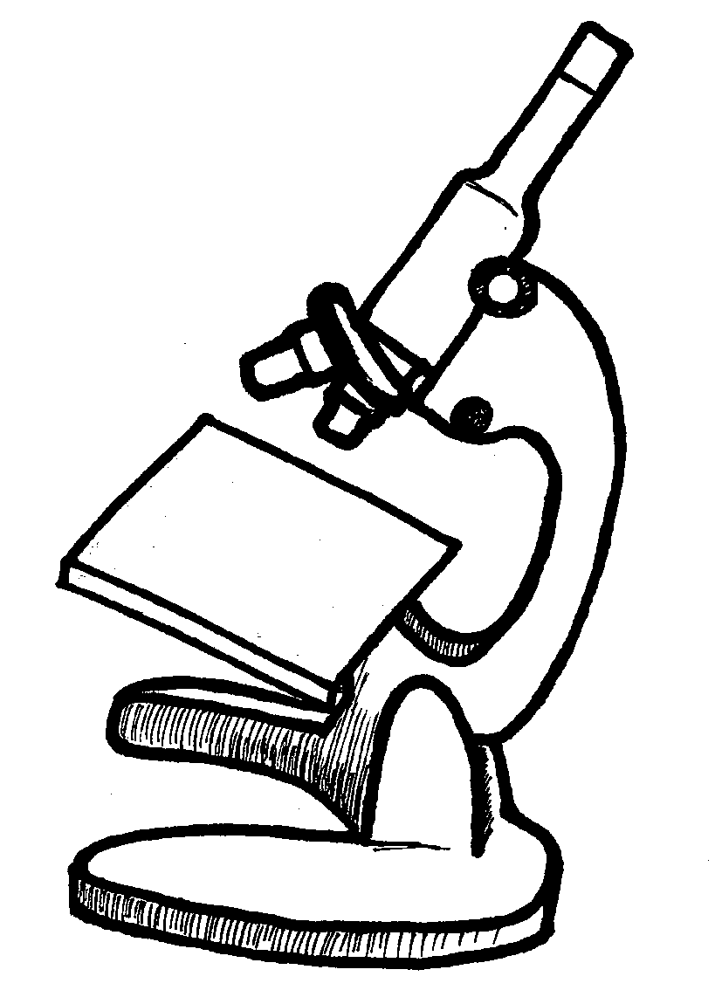
EQuIP Focus on Three-Dimensional Learning

Slide 83
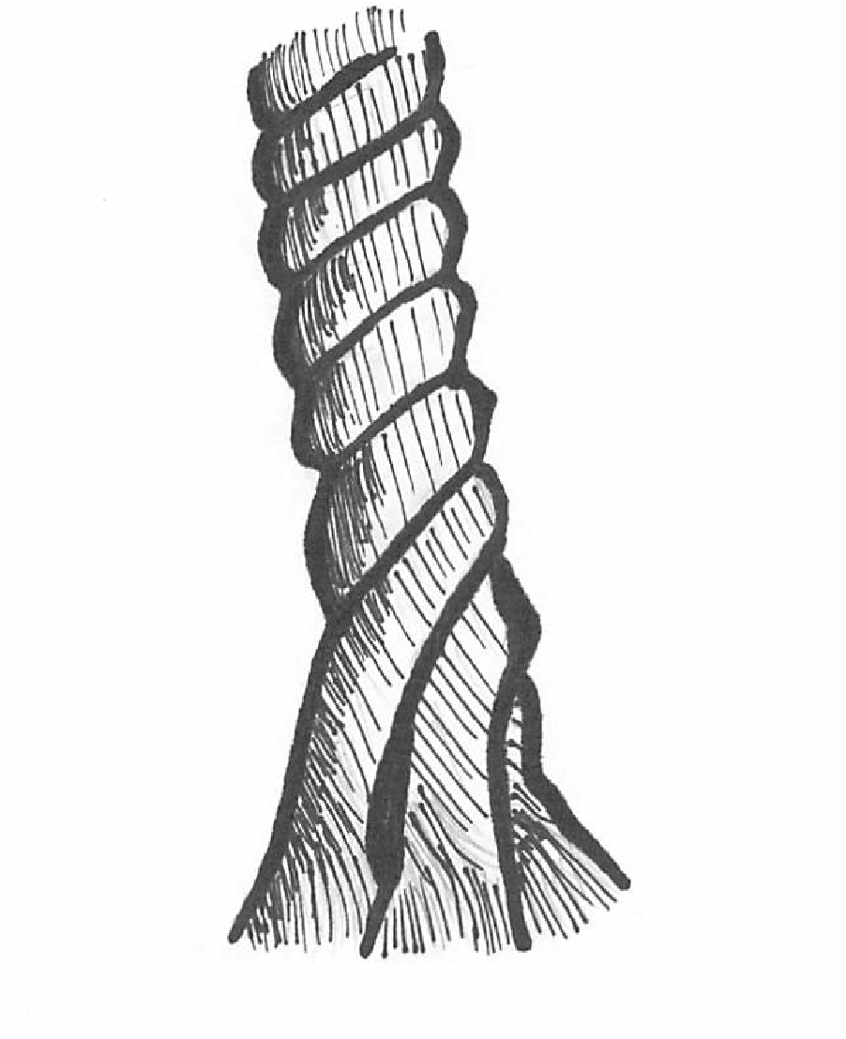
What does Three-Dimensional Learning Look Like?
Crosscutting
Concepts
Core Ideas
Practices

Slide 84
Engaging in Three-Dimensional Learning

Slide 85
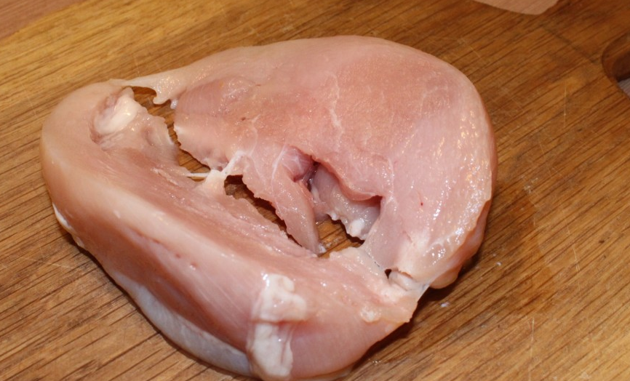
Another Analogy
Three-Dimensional Learning is like making a really great meal?
The cooking techniques are the practices.
The main ingredients are the core ideas.
The herbs and spices are the crosscutting concepts.

Slide 86
Create Your Own Analogy
Three-Dimensional Learning is like _________:
Where _______________ are the Practices;
_______________ are the Core Ideas; and
_______________ are the Crosscutting Concepts.

Slide 87
MS. Waves and their Applications in Technologies for Information Transfer
Students who demonstrate understanding can:
MS-PS4-2. Develop and use a model to describe that waves are reflected, absorbed, or transmitted through various materials. [Clarification Statement: Emphasis is on both light and mechanical waves. Examples of models could include drawings, simulations, and written descriptions.] [Assessment Boundary: Assessment is limited to qualitative applications pertaining to light and mechanical waves.]
Scientific & Engineering Practices
Disciplinary Core Ideas
Crosscutting Concepts
Developing and Using Models
Modeling in 6-8 builds on K-5 and progresses to developing, using, and revising models to describe, test, and predict more abstract phenomena and design systems.
Develop and use a model to describe phenomena.
PS4.A: Wave Properties
A sound wave needs a medium through which it is transmitted.
PS1.B: Chemical Reactions
When light shines on an object, it is reflected, absorbed, or transmitted through the object, depending on the object’s material and the frequency (color) of light.
The path light travels can be traced as straight lines, except at surfaces between different transparent materials.
A wave model of light is useful for explaining brightness, color, and the frequency dependent bending of light at a surface between media.
However, because light…
Structure and Function
Structures can be designed to serve particular functions by taking into account properties of different materials and how materials can be shaped and used.

Slide 88
Engaging in Three-Dimensional Learning

Slide 89
Module 3 Reflection
How is “three-dimensional learning” both the biggest and the most essential shift in the NGSS?
What does “three-dimensional learning” look like in lessons and units in science classrooms?

Slide 90
Module 4: Overview of the EQuIP Rubric

Slide 91
Module 4: Overview of
the EQuIP Rubric
Who developed the EQuIP Rubric and why?
What are the purposes and objectives for using the EQuIP Rubric?
How is the EQuIP Rubric structured?

Slide 92
History of the EQuIP Rubric
EQuIP
Educators
Evaluating the Quality
of Instructional Products

Slide 93
A Few Important Points
The Equip Rubric IS | The Equip Rubric IS NOT
Designed to evaluate LESSONS that include instructional tasks and assessments aligned to NGSS | Designed to evaluate a single task or activity or a full curriculum
Designed to evaluate UNITS that include integrated and focused lessons aligned to the NGSS that extend over a longer period of time | Designed to require a specific template for lessons or units

Slide 94
Purposes & Objectives of the EQuIP Rubric
Review existing lessons and units to determine what revisions are needed;
Provide constructive criterion-based feedback and suggestions for improvement to developers;
Identify exemplars/models for teachers’ use within and across states; and
Inform the development of new lessons and units.

Slide 95
EQuIP Quality Review Agreements
NGSS
Inquiry
Respect & Commitment
Criteria & Evidence
Constructive
Individual to Collective
Understanding & Agreement

Slide 96
The Three-Category Structure of the Rubric
Category I | Category II | Category III
NGSS 3-D Design | NGSS Instructional Supports | Monitoring NGSS Student Progress
The lesson/unit is designed so students learn the three dimensions of the NGSS through three-dimensional student performances that engage students in making sense of phenomena and/or to design solutions to problems. Lessons and units designed for the NGSS include the following: Explaining phenomena/designing solutions Three dimensions Integrating the Three Dimensions | The lesson/unit supports instruction and learning for all students by placing the lesson in a sequence of learning for all three dimensions and providing support for teachers to engage all students in three dimensional learning. Lessons and units designed for the NGSS include the following: Relevance and Authenticity Student Ideas Building Progressions Scientific Accuracy Differentiated Instruction | The lesson/unit supports three dimensional learning by providing feedback to students and teachers about student progress across all three dimensions. Lessons and units designed for the NGSS include the following: 3D student performances Formative assessments Scoring guidance Unbiased tasks/items

Slide 97
The Three-Category Structure of the Rubric
Category I | Category II | Category III
NGSS 3-D Design
The lesson/unit is designed so students learn the three dimensions of the NGSS through three-dimensional student performances that engage students in making sense of phenomena and/or to design solutions to problems. Lessons and units designed for the NGSS include the following: Explaining phenomena/designing solutions Three dimensions Integrating the Three Dimensions

Slide 98
The Three-Category Structure of the Rubric
Category I | Category II | Category III
 | NGSS Instructional Supports
 | The lesson/unit supports instruction and learning for all students by placing the lesson in a sequence of learning for all three dimensions and providing support for teachers to engage all students in three dimensional learning. Lessons and units designed for the NGSS include the following: Relevance and Authenticity Student Ideas Building Progressions Scientific Accuracy Differentiated Instruction

Slide 99
The Three-Category Structure of the Rubric
Category I | Category II | Category III
 |  | Monitoring NGSS Student Progress
 |  | The lesson/unit supports three dimensional learning by providing feedback to students and teachers about student progress across all three dimensions. Lessons and units designed for the NGSS include the following: 3D student performances Formative assessments Scoring guidance Unbiased tasks/items

Slide 100
The Three-Category Structure of the Rubric
Category I | Category II | Category III
NGSS 3-D Design | NGSS Instructional Supports | Monitoring NGSS Student Progress
The lesson/unit is designed so students learn the three dimensions of the NGSS through three-dimensional student performances that engage students in making sense of phenomena and/or to design solutions to problems. Lessons and units designed for the NGSS include the following: Explaining phenomena/designing solutions Three dimensions Integrating the Three Dimensions | The lesson/unit supports instruction and learning for all students by placing the lesson in a sequence of learning for all three dimensions and providing support for teachers to engage all students in three dimensional learning. Lessons and units designed for the NGSS include the following: Relevance and Authenticity Student Ideas Building Progressions Scientific Accuracy Differentiated Instruction | The lesson/unit supports three dimensional learning by providing feedback to students and teachers about student progress across all three dimensions. Lessons and units designed for the NGSS include the following: 3D student performances Formative assessments Scoring guidance Unbiased tasks/items

Slide 101
Module 4 Reflection
Who developed the EQuIP Rubric and why?
What are the purposes and objectives for using the EQuIP Rubric?
How is the EQuIP Rubric structured?

Slide 102
Module 5: Rubric Providing Feedback, Evaluation, and Guidance

Slide 103
Module 5: Providing Feedback, Evaluation, & Guidance
How do we employ evidence, reasoning, feedback, evaluation, and guidance when using the EQuIP Rubric to examine instructional materials?

Slide 104
The Response Form

Slide 105
Evidence
I can see it, point to it in a lesson or unit, highlight it, or quote it directly from what is written.

Slide 106
Reasoning
Use reasoning to explain how the pieces of evidence connect to the rubric criteria.

Slide 107
Feedback
Statements made to teachers, lesson developers, and other educators about what evidence is or is not explicit in a lesson or unit.

Slide 108
Evaluation
Determining whether there is sufficient and compelling evidence to meet the rubric criteria.

Slide 109
Guidance
Suggestions for improvement provided to the developers of the instructional materials we examine.

Slide 110
Elements of the Dimensions
Elements are the grade-level specific bullet points that are displayed in the SEP, DCI, and CCC sections of the foundation boxes, and can be found in the NGSS appendices. They guide learning at specific grade levels.
MS-PS1 Matter and Its Interactions
Students who demonstrate understanding can: MS-PS1-5. Develop and use a model to describe how the total number of atoms does not change in a chemical reaction and thus mass is conserved. [Clarification Statement: Examples of reactions could include burning sugar or steel wool, fat reacting with sodium hydroxide, and mixing zinc with hydrogen chloride.] [Assessment Boundary: Assessment is limited to analysis of the following properties: density, melting point, boiling point, solubility, flammability, and odor.]
The performance expectations above were developed using the following elements from the NRC document A Framework for K-12 Science Education:
Science and Engineering Practices | Disciplinary Core Ideas | Crosscutting Concepts
Developing and Using Models Modeling in 6–8 builds on K–5 and progresses to developing, using and revising models to support explanations, describe, test, and predict more abstract phenomena and design systems. Develop a model to describe unobservable mechanisms. (MS-PS1-5) | PS1.B: Chemical Reactions Substances react chemically in characteristic ways. In a chemical process, the atoms that make up the original substances are regrouped into different molecules, and these new substances have different properties from those of the reactants. (MS-PS1-2), ( MS-PS1-5) The total number of each type of atom is conserved, and thus the mass does not change. (MS-PS1-5) | Energy and Matter Matter is conserved because atoms are conserved in physical and chemical processes. (MS-PS1-5)

Slide 111
Examples of Feedback (1 dimension)
Students are interpreting the data they collected during a visit to a local ecosystem, using the Project Noah website. Students build on these identifications in Investigation 2 when they “analyze and interpret data to provide evidence for phenomena” (NGSS appendix F).
The activity in which students use ratios to estimate population size in a larger area does not help them make sense of the phenomena of biodiversity.

Slide 112
All Written Responses
Criterion-based: Written comments are based on the criteria used for review in each dimension. No extraneous or personal comments are included.
Evidence Cited: Written comments suggest that the reviewer looked for evidence in the lesson or unit that address each criterion of a given dimension. Examples are provided that cite where and how the criteria are met or not met.
Improvement Suggested: When improvements are identified to meet criteria or strengthen the lesson or unit, specific information is provided about how and where such improvement should be added to the material.
Clarity Provided: Written comments are constructed in a
manner keeping with basic grammar, spelling, sentence
structure, and conventions.

Slide 113
Module 5 Reflection
How do we employ evidence, reasoning, feedback, evaluation, and guidance when using the EQuIP Rubric to examine instructional materials?

Slide 114
Module 6: Category I: NGSS 3D Design

Slide 115
Module 6: NGSS 3D Design
How can we work together effectively to examine instructional materials collaboratively in order to determine whether or not they align to the criteria in the EQuIP Rubric?

Slide 116
EQuIP Rubric

Slide 117
Category I, Criterion B
B. Three-Dimensions: Builds an understanding of multiple grade-appropriate elements of the science and engineering practices (SEPs), disciplinary core ideas (DCIs), and crosscutting concepts (CCCs) that are deliberately selected to aid student sense-making of phenomena and/or designing of solutions.
Evidence needs to be at the element level of the dimensions.

Slide 118
Category I, Criterion B , Sub-Criterion i
Provides opportunities to develop and use specific elements of the SEPs.
Evidence needs to be at the element level of the dimensions.

Slide 119
Category I, Criterion B, Sub-Criterion ii
Provides opportunities to develop and use specific elements of the DCIs.
Evidence needs to be at the element level of the dimensions.

Slide 120
Category I, Criterion B, Sub-Criterion iii
Provides opportunities to develop and use specific elements of the CCCs.
Evidence needs to be at the element level of the dimensions.

Slide 121
Category I, Criterion C
C. Student sense-making of phenomena and/or designing of solutions requires student performances that integrate elements of the SEPs, CCCs, and DCIs.

Slide 122
Looking for evidence of 3D learning

Slide 123
What does explicit evidence of the PRACTICES look like?
Investigation1: students are engaged in Analyzing & Interpreting Data (analyzing data to define an optimal operational range for a proposed object, tool, process or system that best meets criteria) and the practice of Planning and Carrying Out Investigations (Collect data about the performance of a proposed object, tool, process, or system under a range of condition) when they collect data and discuss data regarding
the different types of chip
containers.
.

Slide 124
What does explicit evidence of core ideas look like?
.
In Investigation 2, students are asked to consider different forces, “create an annotated diagram of the different forces that a chip might encounter” in the production to sale system. This connects to PS2.A Each force has multiple forces acting on it (3-5 element NGSS) in order to “refine ideas” about forces by engaging in Investigation 2 (testing the effects of different crushing and dropping situations). This investigation is implicitly connecting to a MS element of PS2.A the motion of an object is determined by the sum of the forces acting upon it (NGSS). However, this DCI is not developed and is not used to inform the engineering design.

Slide 125
Implicit vs. Explicit evidence of the crosscutting concept elements
In Investigation 1, students are asked to describe the process product engineers go through as a system. Additionally, students are encouraged to identify system interactions (weight of a steel chip container). However, focusing on the CCC of systems does not help students make sense of the phenomenon of chips breaking/being crushed in chip containers.

Slide 126
What does 3D Design look like?
Crosscutting
Concepts
Core Ideas
Practices

Slide 127
Category IB: NGSS 3D Design

Slide 128
Applying the Criteria to a Lesson
Individually, read through Investigation 1 of the sample lesson provided, and
Highlight evidence of science and engineering practices in BLUE
Highlight evidence of disciplinary core ideas in ORANGE
Highlight evidence of crosscutting concepts in GREEN

Slide 129
Let’s talk about Investigation 1
B. Three-Dimensions: Builds an understanding of multiple grade-appropriate elements of the science and engineering practices (SEPs), disciplinary core ideas (DCIs), and crosscutting concepts (CCCs) that are deliberately selected to aid student sense-making of phenomena and/or designing of solutions.
Evidence needs to be at the element level of the dimensions.

Slide 130
Applying Criteria to a Lesson
Continue to read through the rest of the lesson (including Investigations 2 and 3), and look for (highlight) evidence of the NGSS Category 1B criteria for all 3 Investigations (1,2,3) in the lesson.
In the second column of the response form, record your evidence from the lesson and your evidence from the NGSS on the element level, as well as your reasoning of HOW/WHY this evidence connects to the rubric criteria.

Slide 131
Applying the Criteria to a Lesson
Still working individually, reason how the evidence fits together and connects to criterion 1C Integrating the Three Dimensions. Is there evidence to show that the practices, disciplinary core ideas, and crosscutting concepts:
Work together to support students in three-dimensional learning to make sense of phenomena or to design solutions to problems, OR
Occur in isolation within the lesson

Slide 132
Applying the Criteria to a Lesson
At your table, share and discuss
The evidence you have highlighted as individuals
The reasoning that explains the connections you’ve made between the evidence and the rubric criteria
Your judgments about whether or not you have sufficient and compelling evidence of the rubric criteria by determining an Evidence of Quality rating

Slide 133
Applying the Criteria to a Lesson
Finally, as a group provide suggestions for improvement related to
The incorporation of science and engineering practices, core ideas, and crosscutting concepts; and
The blending of these practices, core ideas, and crosscutting concepts to support students in three dimensional learning

Slide 134
Category 1, Criterion A
Explaining Phenomena/ Designing Solutions: Making sense of phenomena and/or designing solutions to a problem drive student learning.
Student questions and prior experiences related to the phenomenon or problem motivate sense-making and/or problem solving.
The focus of the lesson is to support students in making sense of phenomena and/or designing solutions to problems.
When engineering is a learning focus, it is integrated with developing DCIs from physical, life, and/or Earth and space sciences.

Slide 135
Resource about NGSS Phenomena

Slide 136
Phenomena Video

Slide 137
Applying Criteria to the Lesson
Individually, record evidence AND reasoning of the NGSS Category 1A criteria in the lesson (Investigations 1, 2, and 3) in column 2 of the response form.

Slide 138
Applying the Criteria to a Lesson
At your table, share and discuss
The evidence you have highlighted as individuals
The reasoning that explains the connections you’ve made between the evidence and the rubric criteria
Your judgments about whether or not you have sufficient and compelling evidence of the rubric criteria by determining an Evidence of Quality rating

Slide 139
Applying the Criteria to a Lesson
Finally, as a group provide suggestions for improvement related to
Student questions and prior experiences motivating the sense-making;
The lesson focus as supporting making sense of phenomena or designing solutions to problems; and
The integration of science and engineering

Slide 140
Let’s Share!

Slide 141
Applying the Criteria to Category 1
For Criteria B and C, did you find clear and substantial evidence within the lesson?
For Criteria B and C, did you make any suggestions for improvement?
For Criterion A, did you find clear and substantial evidence within the lesson?
For Criterion A, did you make any suggestions for improvement?

Slide 142
Let’s Rate the Degree to which the criteria were met for Category I
Unit Rating Scale for Category I (A-C only)
3 Extensive evidence to meet at least 2 criteria (and at least adequate evidence for the third).
2 Adequate evidence to meet all three criteria in the category.
1 Adequate evidence to meet at least one criterion in the category, but insufficient evidence for at least one other criterion.
0 Inadequate (or no) evidence to meet any of the criteria in the category.

Slide 143
Debrief and Generalizing
What issues, “a-ha” moments, or other discoveries did you experience as you used the rubric to examine this sample lesson?
What questions or suggestions do you have for the next time?

Slide 144
Module 6 Reflection
How can we work together effectively to examine instructional materials collaboratively in order to determine whether or not they align to the criteria in the EQuIP Rubric?

Slide 145
Module 7: Determining Coherence
and Connections

Slide 146
Module 7: Determining Coherence & Connections
How can we determine whether NGSS lessons and units demonstrate coherence and include relevant connections?

Slide 147
EQuIP Rubric

Slide 148
Using Phenomena to engage students in science

Slide 149
Phenomena and Student Questions

Slide 150
Coherence Criteria
Unit Coherence: Lessons fit together to target a set of performance expectations.
Multiple Science Domains: When appropriate, links are made across the science domains of life science, physical science, and earth and space science.
Math and ELA: Provides grade-appropriate connection(s) to the Common Core State Standards.

Slide 151
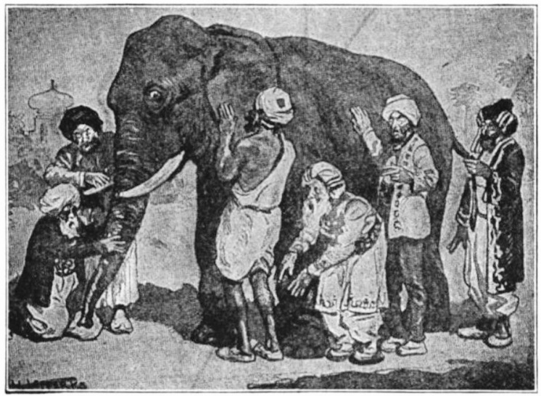
What is Coherence?

Slide 152
Coherence Questions (1 of 2)
When determining whether or not a series of lessons or a unit demonstrates coherence, try asking the following questions:
Can students see how what they are trying to figure out in a lesson fits into a larger storyline for making sense of phenomena or for designing solutions?

Slide 153
Coherence Questions (2 of 2)
2. Is there a coherent story, based on evidence found in the lessons, that builds across the unit to reach a bundle of performance expectations?

Slide 154
What Is a Storyline?
Q
A

Slide 155
What’s the Storyline Here?

Slide 156
A Graphic Representation of Coherence

Slide 157
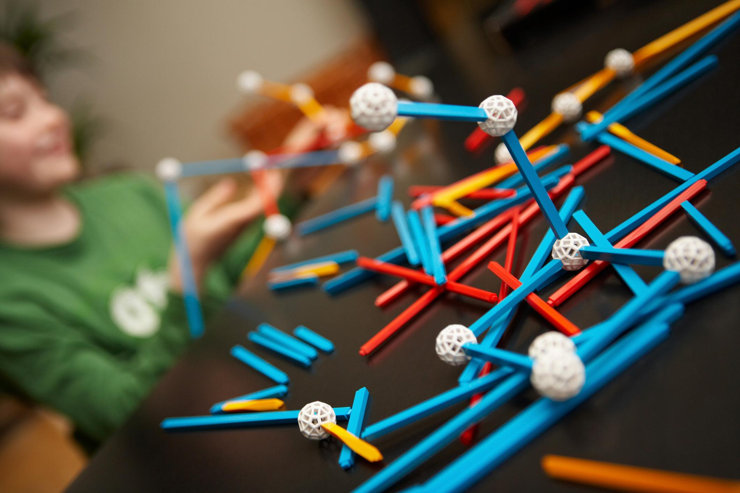
Connections Across Science Disciplines

Slide 158
Connections Between Science & ELA or Math

Slide 159
Determining Coherence & Connections

Slide 160
The Process for Determining Coherence & Connections
Evidence
SUFFICIENT & COMPELLING EVIDENCE OF EQuIP RUBRIC CRITERIA
Suggestions
Reasoning
Consensus

Slide 161
Debrief
Can a lesson or unit be organized but not coherent? How?
Can a lesson or unit be coherent and include connections but not be aligned to the rubric criteria? How?
What are the implications if we don’t find coherence in lessons or units?

Slide 162
Module 7 Reflection
How can we determine whether NGSS lessons and units demonstrate coherence and include relevant connections?

Slide 163
Module 8: Category II: Instructional Supports

Slide 164
Module 8: Instructional Supports
How do we determine whether or not a lesson or unit supports instruction for all learners?

Slide 165
Instructional Supports
The lesson or unit supports instruction and learning for all students.
It’s all about ACCESS!

Slide 166
Lessons or Units
How do the criteria and sub-criteria for lessons or units (A-E) provide access and support instruction and learning for all students?

Slide 167
Longer Lessons or Units
Providing guidance for teachers
Providing and adjusting supports for students over time

Slide 168
Response Form, pp 9-10

Slide 169
Quick Practice
Evidence
SUFFICIENT & COMPELLING EVIDENCE OF EQuIP RUBRIC CRITERIA
Suggestions
Reasoning
Consensus

Slide 170
Debrief
What evidence did you find to support the criteria for Category II?
What makes you think this evidence is/is not sufficient and of the quality necessary to meet the criteria for Category II?
What are the implications if a lesson or unit does not meet the criteria for Category II?

Slide 171
Let’s Rate the Degree to which the criteria were met for Category II
Unit Rating Scale for Category II (A-E only)
3 At least adequate evidence for all criteria in the category, extensive evidence for at least one criterion.
2 Some evidence for all criteria in the category and adequate evidence for at least 5 criteria, including A
1 Adequate evidence for at least three criteria in the category
0 Adequate evidence for no more than 2 criteria in the category

Slide 172
Module 8 Reflection
How do we determine whether or not a lesson or unit supports instruction for all learners?

Slide 173
Module 9: Category III: Monitoring Student Progress

Slide 174
Module 9: Monitoring Student Progress
How will we know if students are learning?

Slide 175
EQuIP Rubric

Slide 176
Monitoring Progress in a Lesson or Unit
Monitoring 3D student performances: Direct, observable evidence of three-dimensional learning
Embedded formative assessments
Rubrics and scoring guidelines
Accessible and unbiased assessment methods

Slide 177
What Does Formative Assessment Look Like?
Formative assessment is a process used by teachers and students during instruction that provides feedback to adjust ongoing teaching and learning to improve students’ achievement of intended instructional outcomes.

Slide 178
Evidence of student learning

Slide 179
What Does Formative Assessment Look Like?
Learning Progressions
Learning Goals and Criteria for Success
Descriptive Feedback
Self- and Peer-Assessment
Collaboration

Slide 180
Examples/Non-Examples
Is there evidence of:
A learning progression?
Learning goals and success criteria?
Intent to provide descriptive feedback?
Opportunity for self- and peer-assessment?
Collaboration between teacher and students?

Slide 181
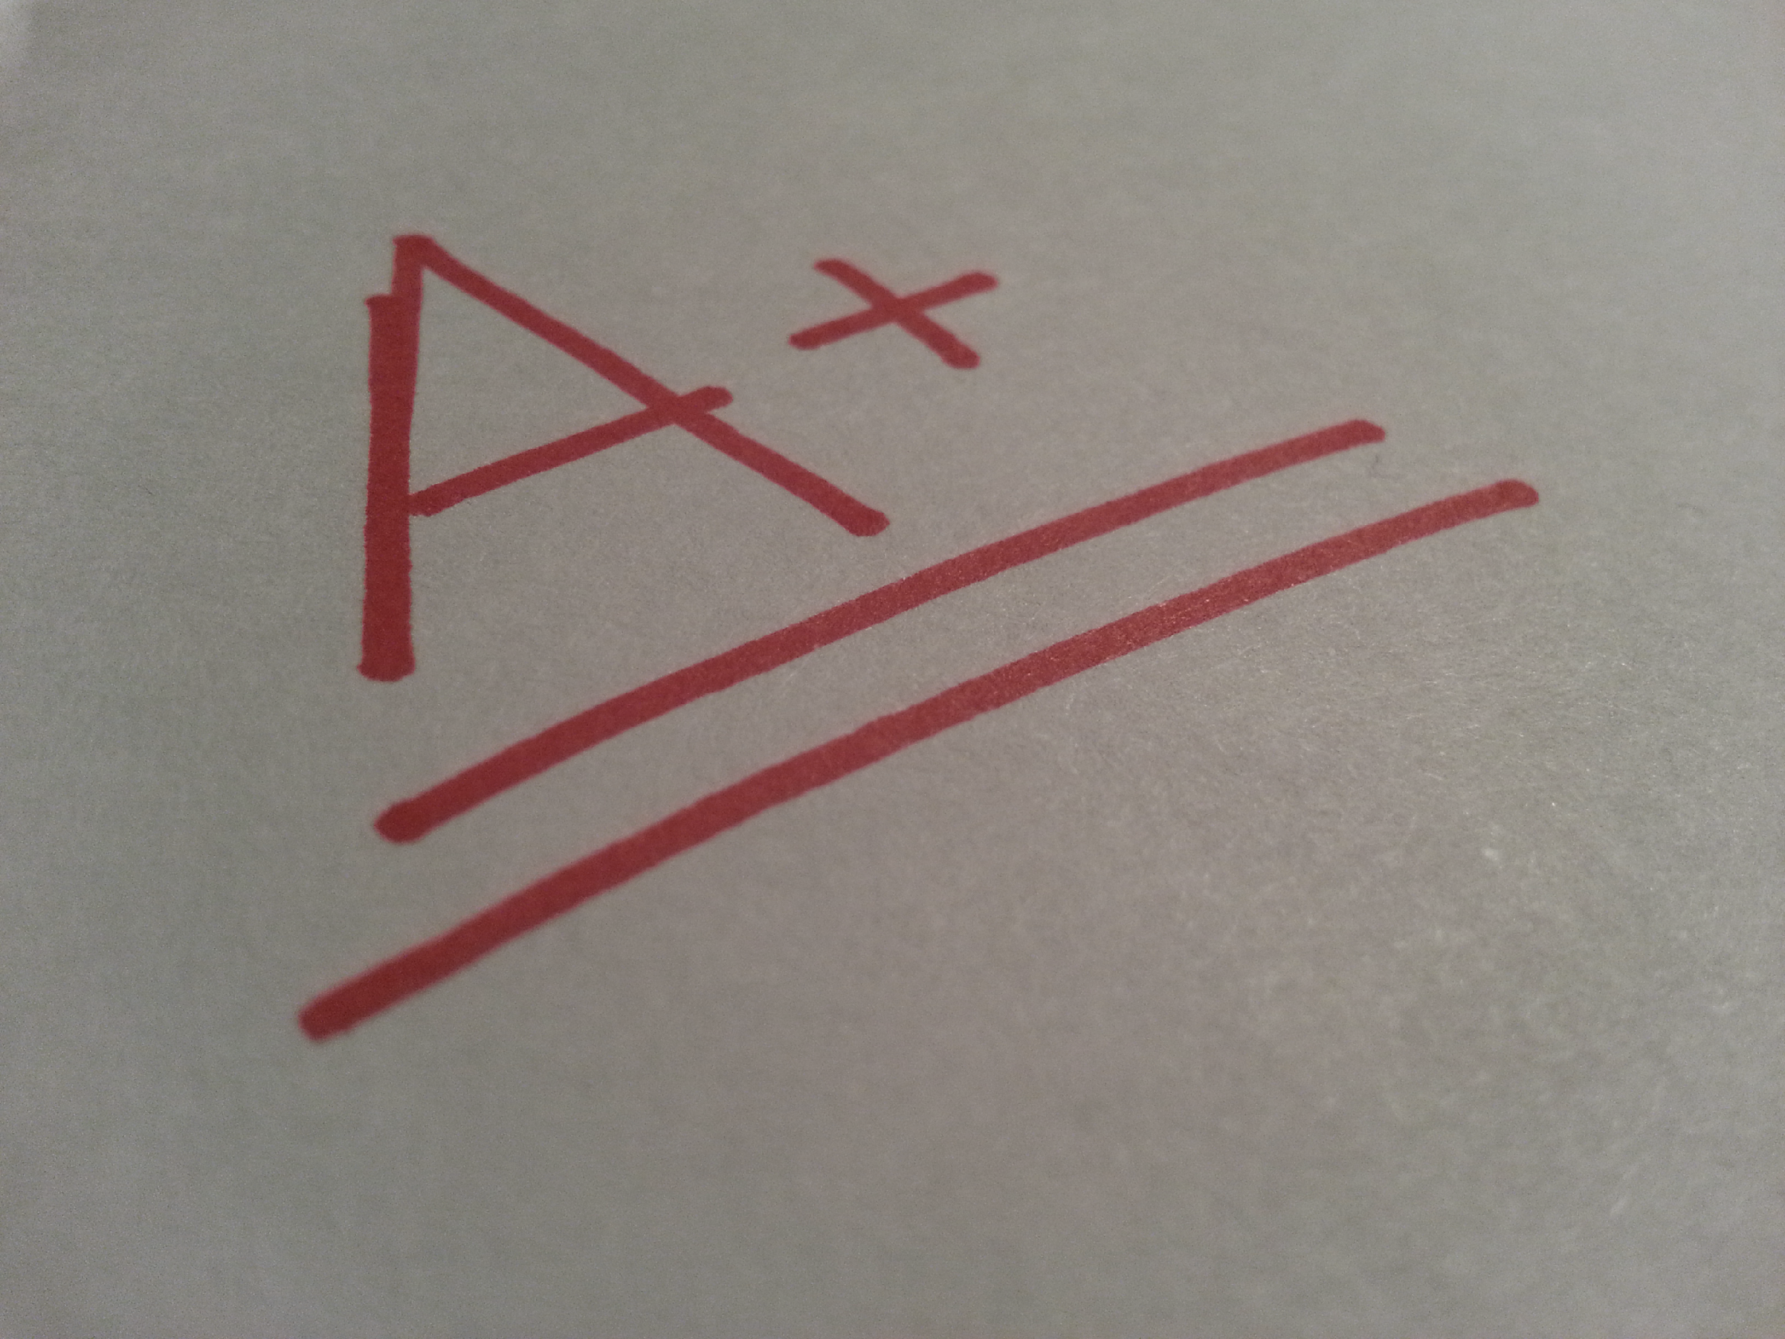
Formative vs. Summative Assessment

Slide 182
Monitoring Progress in a Lesson or Unit
Monitoring 3D student performances: Direct, observable evidence of three-dimensional learning
Embedded formative assessments
Rubrics and scoring guidelines
Accessible and unbiased assessment methods

Slide 183
Monitoring Progress in Units or Longer Lessons
Coherent Assessment System: Pre-, formative, summative, and self-assessments that assess three-dimensional learning
Multiple opportunities for students to learn and demonstrate performance

Slide 184
Response Form, p. 12

Slide 185
Quick Practice
Evidence
SUFFICIENT & COMPELLING EVIDENCE OF EQuIP RUBRIC CRITERIA
Suggestions
Reasoning
Consensus

Slide 186
Debrief
What evidence did you find to support the criteria for Category III?
What makes you think this evidence is/is not sufficient and of the quality needed to meet the criteria for Category III?
Why is it important to measure student understanding on all three dimensions of learning?

Slide 187
Let’s Rate the Degree to which the criteria were met for Category III
Unit Rating Scale for Category III (A-D only)
3 At least adequate evidence for all criteria in the category, extensive evidence for at least one criterion.
2 Some evidence for all criteria in the category and adequate evidence for at least 5 criteria, including A
1 Adequate evidence for at least two criteria in the category
0 Adequate evidence for no more than one criterion in the category

Slide 188
Overall Rating for Lesson/Unit

Slide 189
Module 9: Reflection
How will we know if students are learning?

Slide 190
Module 10: Culminating Task

Slide 191
Module 10: Culminating Task

Slide 192
Your Task
Use the EQuIP Rubric to examine a series of lessons or a unit of instruction developed for your specific grade, grade band or science discipline.

Slide 193
Remember
The Equip Rubric IS | The Equip Rubric IS NOT
Designed to evaluate LESSONS that include instructional tasks and assessments aligned to NGSS | Designed to evaluate a single task or activity or a full curriculum
Designed to evaluate UNITS that include integrated and focused lessons aligned to the NGSS that extend over a longer period of time | Designed to require a specific template for lessons or units

Slide 194
The Process
Evidence
SUFFICIENT & COMPELLING EVIDENCE OF EQuIP RUBRIC CRITERIA
Suggestions
Reasoning
Consensus

Slide 195
Working As a Group
When working in a group, teams may choose to compare findings after each category or delay conversation until each person has examined and recorded input for all three categories. Complete consensus among team members is not required but discussion is a key component of the review process.

Slide 196
Quick Practice
Evidence
SUFFICIENT & COMPELLING EVIDENCE OF EQuIP RUBRIC CRITERIA
Suggestions
Reasoning
Consensus

Slide 197
Culminating Task Reflection

Slide 198
Professional Development Goal
Participants who successfully complete all ten segments of this training will be able to use the EQuIP Rubric version 3.0 to examine lessons or units—published or educator-generated—specific to their grade, grade band, or area of science.

Slide 199
The Challenge
As trained reviewers of instructional materials, go forth and
USE THE EQuIP RUBRIC
SHARE IT WITH COLLEAGUES

