Slide 2
What is Three-Dimensional Learning?
Three-dimensional learning shifts the focus of the science classroom to environments where students use core ideas, crosscutting concepts with scientific practices to explore, examine, and use science ideas to explain how and why phenomena occur or to design solutions to problems.

Slide 3
“Learning About” or “Figuring Out”
Explanatory ideas are important so that students are figuring out phenomena and not just learning about facts and details.
Science and engineering practices build explanatory ideas.

Slide 4
Student Hat --- Teacher Hat

Slide 5
Designing NGSS Units

Slide 6
APhenomena: Optical Illusions

Slide 8
Notes:
https://youtu.be/Ea9kU1eSuW8?t=37s

Slide 9
Notes:
https://www.youtube.com/v/gfvMU36fgKw

Slide 10
Optical illusions: how do these images work?
With your table, develop your own questions that will drive our quest to figure out these optical illusions. Place these Qs on a post it and place on one of our 3 Driving Question Boards.
What are some questions you have about the optical illusions, eyes, vision, and how we see?

Slide 11
Driving Question: Can I trust my eyes?
Lesson level question:
What do you need in order to see an object?

Slide 12
Light Box 1: Create this data table
Data
 | Observation
First: Lid Closed and Flap Closed
Second: Lid Closed and Flap Open

Slide 13
How can I see an object?
Look into the shoebox with the flap CLOSED.
Think about:
How does that help you understand how you can see the object?

Slide 14
How can I see an object?
Look into the shoebox with the flap OPEN.
Think about:
How does that help you understand how you can see the object?

Slide 15
Light Box 1
Data
 | Observation
First: Lid Closed and Flap Closed
Second: Lid Closed and Flap Open
Making Sense
Leverage Patterns: How were your 2 observations different?

Slide 16
Light Box 2
Add the divider to your light box. Keep the box lid closed and the slide flap open.
Draw what you see and include as much detail as you can.

Slide 17
Create a MODEL to help explain how we saw what we did in the 3 stages of the light box
Include:
Components (relevant parts)
Relationships (how the components interact)
What moves? What changes?
Connections (to big science ideas, processes, theories, or laws)

Slide 18
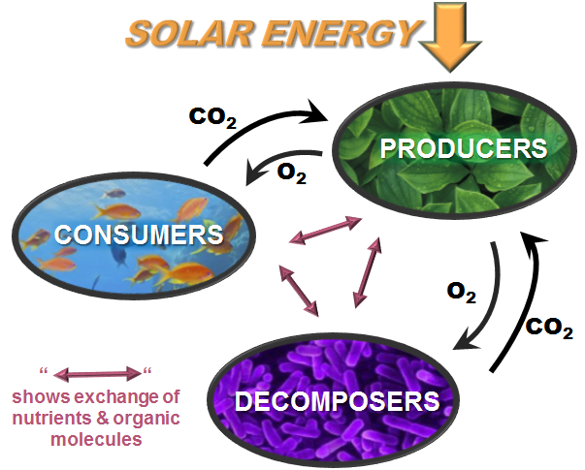
Crosscutting Concept: System and System Models
Models
Components
Relationships
Energy and Matter flows
Inputs
Flow
Output

Slide 19
Create a MODEL to help explain how we saw what we did in the 3 stages of the light box
Include:
Components (relevant parts)
Relationships (how the components interact)
What moves? What changes?
Connections (to big science ideas, processes, theories, or laws)

Slide 20
Why can the girl see the tree?

Slide 21
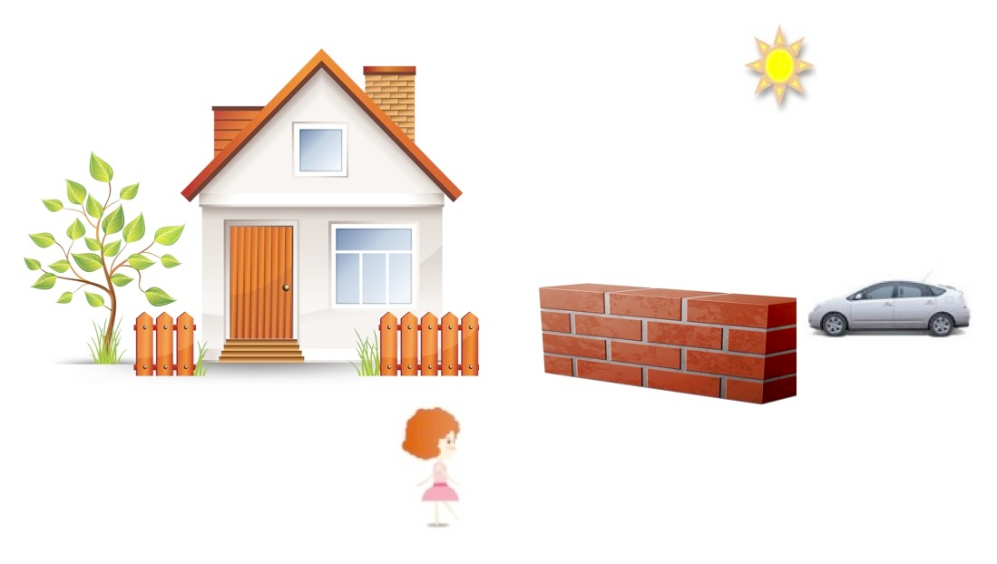
Why can’t the girl see the car?

Slide 22
Create a MODEL to help explain how we saw what we did in the 3 stages of the light box
Include:
Components (relevant parts)
Relationships (how the components interact)
What moves? What changes?
Connections (to big science ideas, processes, theories, or laws)

Slide 23
Consensus Model
At your table, share your models.
EXPLAIN the components and the relationship between the components.
Using your table talk discussion and the visible thinking of group members, create a consensus model together to explain vision. These models will become part of a gallery walk.

Slide 24
Storyline for the Unit
Goal: Making sense of phenomena
Driving Question: Can I trust my eyes?
Optical Illusions
Investigate and build knowledge through practices and CCCs
Incrementally Build Explanations, Models, or Designs
Phenomena-driven Questions
What do you need to see?
Models, PS4
Systems
Initial explanation, model or design
How does light get to our eyes?
How does light allow vision?
Models, Explain, LS1
S&F, Systems
Add to/revise
How does the brain process signals?
Models, Explain, LS1,
S&F, Systems
Add to/revise
What happens when light reaches an object?
Explanations, Models PS4
Systems, S&F
Final consensus explanation, model or design

Slide 25
Models at the beginning of the Unit

Slide 26
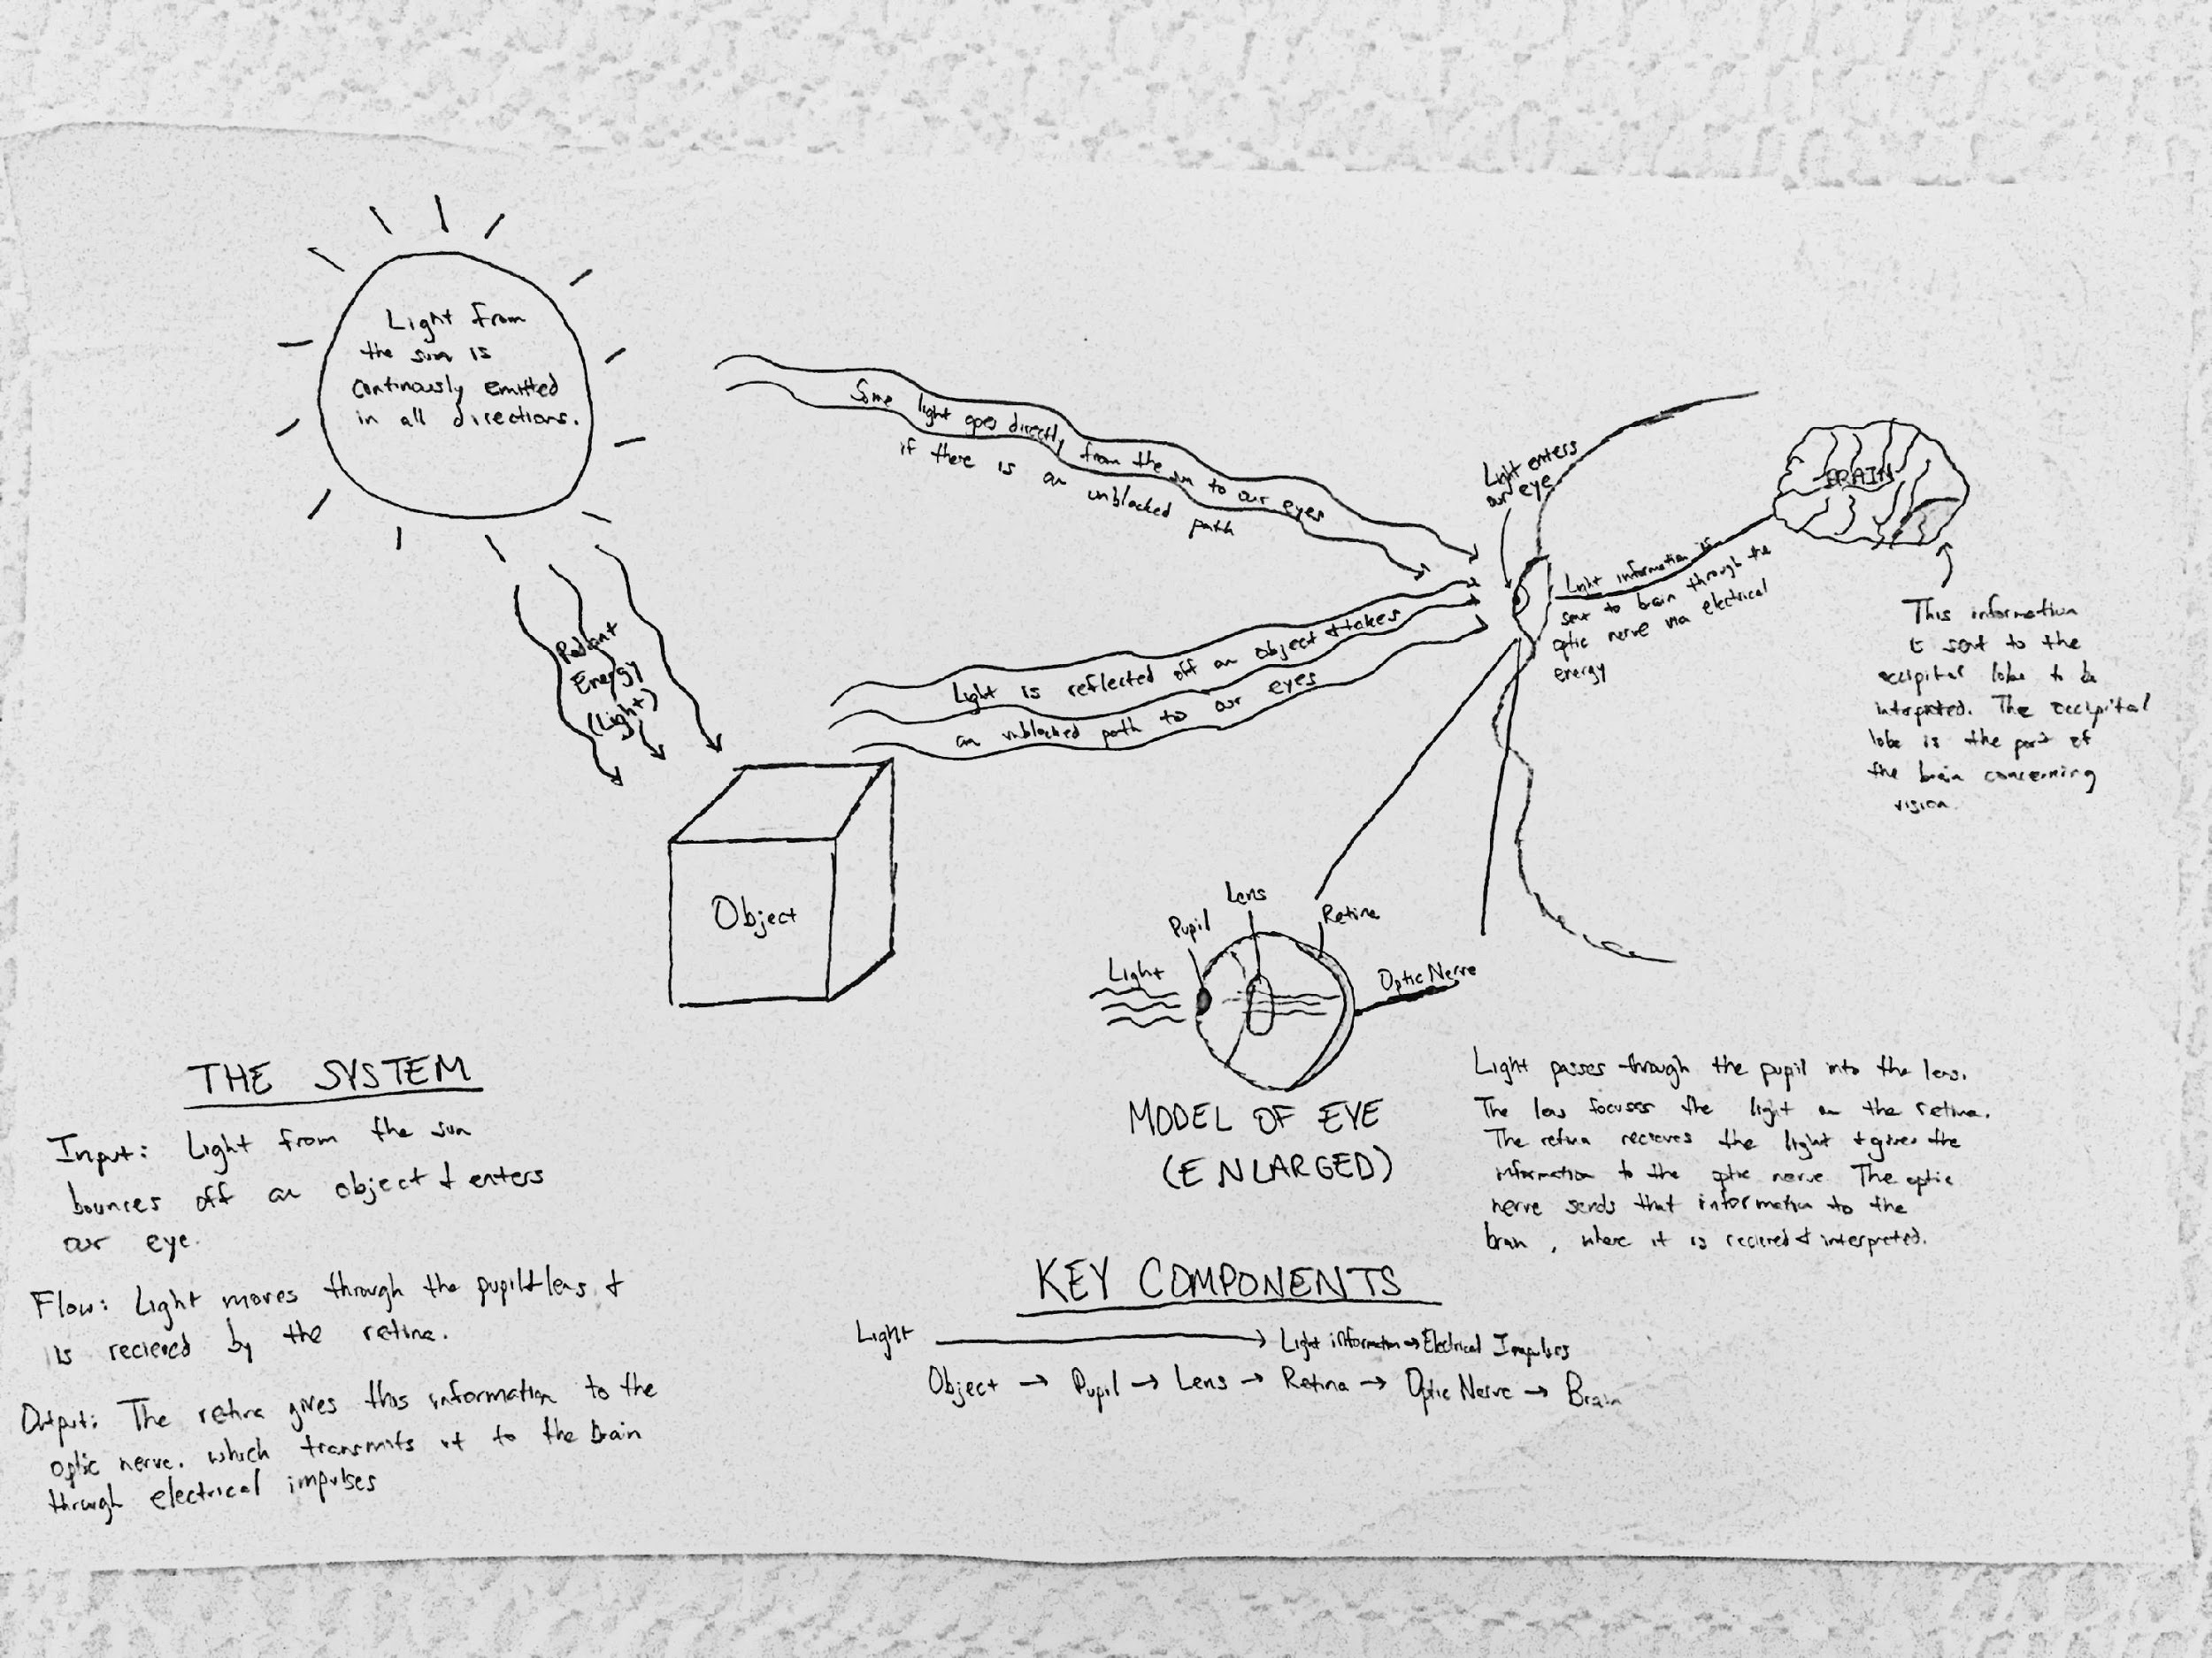
Models in the Middle of the Unit

Slide 27
When evaluating student artifacts
What does “this” artifact tell you about student understanding at the given point in the lesson?
Disciplinary Core ideas
Crosscutting Concepts
Science and Engineering Practices

Slide 28
What have we figured out?
Examine your 2 student artifacts. Using your MS-PS4 Handout, determine if the artifact(s) have evidence of student understanding of the Disciplinary Core Idea (DCI) or Crosscutting Concept (CCC) elements found on the handout.
Highlight the elements that you determine the students have communicated understanding of with their models.

Slide 29
How have students engaged in SEP’s to Figure out?
Examine your 2 student artifacts. Using your Grades 6-8 and Grades 9-12 Science and Engineering (SEP) Handouts, determine which elements of the practices can be evidenced by these student artifacts.
Highlight the elements that you determine the students have communicated understanding of with their models.

Slide 30
Table Share
Each pair should share their evidence (specific elements) of student opportunities to use each of the 3 dimensions to figure out our lesson-level phenomena.
As a group, discuss any evidence of evolving 3-dimensional understanding. (comparing model 1 to model 2).

Slide 31
Models at the beginning of the Unit

Slide 32
Models in the Middle of the Unit

Slide 33
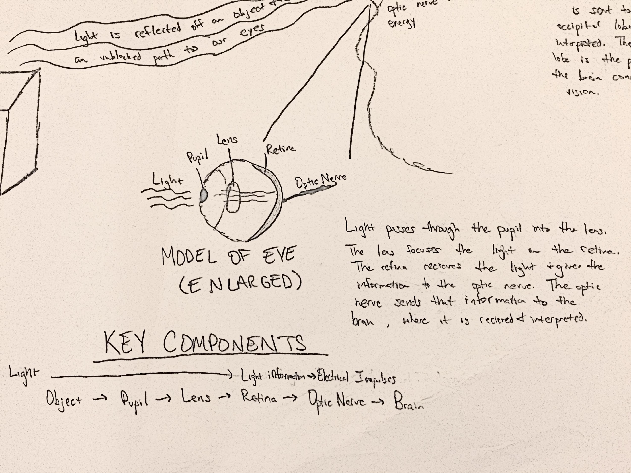
Models in the Middle of the Unit

Slide 34
Models in the Middle of the Unit

Slide 35
Models in the Middle of the Unit

Slide 36
What pieces of the puzzle are we building?
When light shines on an object, it is reflected, absorbed, or transmitted through the object, depending on the object’s material and the frequency (color) of light.
The path that light travels can be traced as straight lines. (PS4.A)
The path that light takes travels in straight lines.
There are four necessary components of vision, an eye, an object, a light source, and a straight path between the eye and the object.
Models can be used to represent systems and their interactions (inputs, outputs, flows) and energy, matter, & info flows within systems. (Appendix G, NGSS).
Light transfers energy from place to place.

Slide 37
What pieces of the puzzle are we building?
When light shines on an object, it is reflected, absorbed, or transmitted through the object, depending on the object’s material and the frequency (color) of light.
The path that light travels can be traced as straight lines. (PS4.A)
The path that light takes travels in straight lines.
There are four necessary components of vision, an eye, an object, a light source, and a straight path between the eye and the object.
Models can be used to represent systems and their interactions (inputs, outputs, flows) and energy, matter, & info flows within systems. (Appendix G, NGSS).
Light transfers energy from place to place.

Slide 38
Coherence in Lessons
What do students figure out in a lesson?
How is this related to the DCIs?

Slide 39
Can we explain how optical illusions work?

Slide 40
Students building understanding piece by piece with each lesson

Slide 41
What pieces of the puzzle are we building?
Each sense receptor responds to different inputs (electromagnetic, mechanical, chemical) transmitting them as signals that travels along nerve cells to the brain. The signals are then processed in the brain, resulting in immediate behaviors or memories.
The eye receives the light energy (electromagnetic radiation) and sends that signal via electrical impulse (energy) via the optic nerve to the brain.
Multicellular organisms are organized into levels of organization where the parts work together to accomplish a function.
The eye itself is made of numerous subparts that function together for vision.
Multicellular organisms have a hierarchical structural organization, in which any one system is made up of numerous parts and is itself a component of the next level. (LS1A)

Slide 42
What pieces of the puzzle are we building?
Energy is transferred from one object to another and, in addition, often changes forms. However, it is not created or destroyed, meaning energy input and energy output is always equal.
…There is a single quantity called energy.. Energy is continually transferred from one object to another and in between its various possible forms. (PS3A)
Energy cannot be created or destroyed… (PS3B)
Light transfers energy from place to place. Light energy is transformed into electrical energy so the vision information message can be processed by the brain.
Models can be used to simulate systems and interactions including energy, matter, and information flows- within and between systems at different scales.

Slide 43
Storyline for the Unit
Goal: Making sense of phenomena
Driving Question: Can I trust my eyes?
Optical Illusions
Investigate and build knowledge through practices and CCCs
Incrementally Build Explanations, Models, or Designs
Phenomena-driven Questions
What do you need to see?
Models, PS4
Systems
Initial explanation, model or design
How does light get to our eyes?
How does light allow vision?
Models, Explain, LS1
S&F, Systems
Add to/revise
How does the brain process signals?
Models, Explain, LS1,
S&F, Systems
Add to/revise
What happens when light reaches an object?
Explanations, Models PS4 Systems, S&F
Final consensus explanation, model or design

Slide 44
Our questions left unanswered create a need to engage in the next lesson
Coherence:
Building ideas, piece by piece,
over time by
making sense of phenomena and solving problems

Slide 45
NGSS 3D Design for Instruction and Assessments
Three Dimensions: Grade-appropriate elements of the Science and Engineering practices, disciplinary core ideas, and crosscutting concepts are designed into student learning experiences.
3D Student Performances
At least one student performance that blends the elements of SEP’s, DCI’s, and CCC’s is central to student learning experience.

Slide 46
NGSS 3D Design for Instruction and Assessments
Phenomena:
Lesson Level performances engage students in making sense of phenomena.
Coherence:
Each lesson links to a previous lesson and provides a need to engage in the current lesson.
Building understanding over time/ breaking up an important idea into small pieces.

Slide 47
Rationale: What’s the Purpose of the EQuIP Rubric

Slide 48
Professional Learning Goals
Participants who successfully complete all ten segments of this training will be able to use the EQuIP Rubric to examine lessons or units—published or educator-generated—specific to their grade, grade band, or area of science.

Slide 49
NGSS Innovations
Take two minutes and write down the biggest innovations in the NGSS.

Slide 50
NGSS Innovations (1 of 3)
Explaining Phenomena & Designing Solutions: Making sense of phenomena or designing solutions to problems drives student learning. Science education should reflect science as it is practiced and experienced in the real world.
Innovation 2—Three Dimensional­ Learning: Students making sense of phenomena or designing of solutions to problems requires student performances that integrate elements of the SEPs, CCCs, and DCIs in instruction and assessment.
All three dimensions valued
Three dimensions integrated
3D Instruction and Assessment

Slide 51
NGSS Innovations (2 of 3)
Building K-12 Progressions: Student three dimensional learning experiences are coordinated and coherent over time to ensure students build understanding of all three dimensions of the standards, the Nature of Science (NOS), and Engineering as expected by the standards.
Alignment with English Language Arts and mathematics: Students engage in learning experiences with explicit connections to and alignment with English language arts (ELA) and mathematics.

Slide 52
NGSS Innovations (3 of 3)
All Standards, All Students: These standards are designed to provide equitable opportunity to learn for all students to be productive citizens, not just a list of science information for those pursuing science-related careers.

