Slide 1
Module 7: Determining Coherence
and Connections
Notes:
Slide 145

Slide 2
Module 7: Determining Coherence & Connections
How can we determine whether NGSS lessons and units demonstrate coherence and include relevant connections?
Notes:
Slide 146

Slide 3
EQuIP Rubric
Notes:
Slide 147

Slide 4
Using Phenomena to engage students in science
Notes:
Slide 148

Slide 5
Phenomena and Student Questions
Notes:
Slide 149

Slide 6
Coherence Criteria
Unit Coherence: Lessons fit together to target a set of performance expectations.
Multiple Science Domains: When appropriate, links are made across the science domains of life science, physical science, and earth and space science.
Math and ELA: Provides grade-appropriate connection(s) to the Common Core State Standards.
Notes:
Slide 150

Slide 7
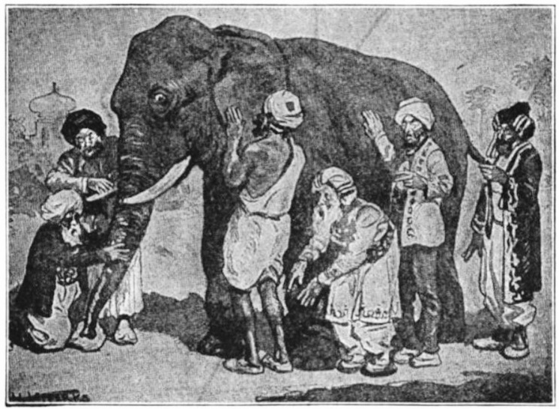
What is Coherence?
Notes:
Slide 151

Slide 8
Coherence Questions (1 of 2)
When determining whether or not a series of lessons or a unit demonstrates coherence, try asking the following questions:
Can students see how what they are trying to figure out in a lesson fits into a larger storyline for making sense of phenomena or for designing solutions?
Notes:
Slide 152

Slide 9
Coherence Questions (2 of 2)
2. Is there a coherent story, based on evidence found in the lessons, that builds across the unit to reach a bundle of performance expectations?
Notes:
Slide 153

Slide 10
What Is a Storyline?
Q
A
Notes:
Slide 154

Slide 11
What’s the Storyline Here?
Notes:
Slide 155

Slide 12
A Graphic Representation of Coherence
Notes:
Slide 156

Slide 13
Connections Across Science Disciplines
Notes:
Slide 157

Slide 14
Connections Between Science & ELA or Math
Notes:
Slide 158

Slide 15
Determining Coherence & Connections
Notes:
Slide 159

Slide 16
The Process for Determining Coherence & Connections
Evidence
SUFFICIENT & COMPELLING EVIDENCE OF EQuIP RUBRIC CRITERIA
Suggestions
Reasoning
Consensus
Notes:
Slide 160

Slide 17
Debrief
Can a lesson or unit be organized but not coherent? How?
Can a lesson or unit be coherent and include connections but not be aligned to the rubric criteria? How?
What are the implications if we don’t find coherence in lessons or units?
Notes:
Slide 161

Slide 18
Module 7 Reflection
How can we determine whether NGSS lessons and units demonstrate coherence and include relevant connections?
Notes:
Slide 162

