Slide 1
PEEC Professional Learning
Primary Evaluation of Essential Criteria (PEEC) for NGSS Instructional Materials Design
Notes:
Facilitator Notes:

Slide 2
Session One
Day 1
Immersion
Notes:
Facilitator Notes:
The purpose of this session is to bring together a large group of reviewers to evaluate whether instructional materials programs are designed for the NGSS.
Even though, ideally, all participants will have a basic understanding of the NGSS, it is important that they have a common understanding and that there are no misconceptions before they dive into evaluating instructional materials programs. All participants will participate in an immersion activity as students, and then will look for evidence of three-dimensional learning in the activity as teachers. The discussions that emerge from this activity will be a great level-setting opportunity.
The leadership team has engaged in this session’s immersion activity during their Leadership Team Planning Session. The team members should help lead the immersion activity and serve as table/group facilitators.

Slide 3
Session One
Day 1
Immersion
Notes:
Facilitator Notes:
Before you begin the session, it will be important to think about how you want to group participants. Ideally, participants will be in teams of four to six members, as this size gives everyone an opportunity to be part of the team discussion. You may wish to group participants with varying levels of knowledge (i.e. spread out educators who have an understanding of the NGSS into separate groups), to allow for a rich discussion with multiple perspectives.
Talking Points:
[Note to facilitator: Create talking points for a welcome and introductions. If people in the room do not know each other, include an ice breaker activity to get the day started.]

Slide 4
The goals of this session are to:
Build a common understanding of the NGSS and its Innovations
Notes:
Facilitator Notes:
This slide will explain the goal of the session to participants.
Talking Points:
The goal of this session is to build a common understanding of the NGSS and its Innovations
Today, you will take part in an immersion activity as a student and a teacher to build your understanding of the NGSS Innovations. These innovations are the lens that PEEC uses to help educators evaluate instructional materials, so it is important that before you begin to evaluate instructional materials in Sessions Two and Three you understand the innovations.

Slide 5
Then vs. Now
Think about what science instruction and learning looked like back when you were a student in school.
How have science and technology changed over the years from when you were a student?
How do you think that has changed how science should be taught and learned in classrooms?
Notes:
Facilitator Notes:
The participants in the session may be a mix of educators, administrators, and/or parents. Their knowledge about the shift in science standards and the NGSS may vary greatly, and not all participants may understand how or why science education is changing, and in turn, how instructional materials will look different from when they were students. This slide is structured to allow participants time to personally reflect on their experiences and with opportunities to discuss their experiences and their thoughts about how instruction and learning should be changing in the science classroom to match the evolution of science and technology. This will help participants understand the need to update instructional materials.
The thought bubble and conversation bubble icons indicate that the statement/questions listed on the slide are for participants to think about and then discuss with their group. These icons will reappear throughout the professional learning slides to help support the facilitator's talking points in a visual manner for participants. The talking points below provide a recommended structure for this conversation.
Each group will need chart paper and markers for this activity.
Talking Points:
What makes the Next Generation Science Standards (NGSS) new and different from past science standards? [Note to facilitator: Click for animation.] Take a few minutes to think about what science instruction and learning looked like back when you were a student in middle/high school or college. What did instruction look like? What was the role of the student vs. the teacher? [Note to facilitator: Give participants a minute for personal reflection.] Discuss your thoughts with your group. [Note to facilitator: Give participants 5 minutes for their group discussions.]
Now think about how science and technology have changed over the years from when you were a student? [Note to facilitator: Click for animation.] How do you think that has changed how science should be taught and learned in the classroom? [Note to facilitator: Click for animation.] Discuss your thoughts with your group. [Facilitator Note: Give participants 5 minutes for their group discussions.]
On the chart paper provided for you, create a T-chart and list your big ideas about what science education and standards used to look like when you were a student, and what science education and standards are shifting toward now. [Note to facilitator: Give participants 5 minutes for this activity. After groups are finished creating their T-chart, have them post their chart where everyone can see it.]
Let’s have each group share their chart. [Note to facilitator: Have each group present their chart to the room.]

Slide 6
NGSS Innovations
Making sense of phenomena and designing solutions to problems
Three-dimensional learning
Building K-12 progressions
Alignment with English Language Arts and Mathematics
All Standards, All Students
Notes:
Facilitator Notes:
The NGSS innovations will be briefly introduced here to tie into the discussion from the previous slide. Each innovation will be presented further in depth later on in the professional learning sessions as needed for participants to understand the three PEEC phases. The handout that participants will begin to fill out in this slide, Handout 1 – NGSS Innovations, will help track how participants’ understanding of the NGSS innovations changes throughout the professional learning sessions.
Tailor the talking points to build on any ideas that may have surfaced in the previous discussion when groups shared their ideas in the form of their T-chart.
Participants will need a copy of Handout 1 - NGSS Innovations.
Talking Points:
We just discussed the shifts that we have seen in general for science education. Let’s now talk specifically about the innovations of the NGSS.
The vision of the NGSS is based on scientific advances and educational research about how students best learn science. The NGSS are new and different from past science standards in that there are five innovations.
The five NGSS innovations are: making sense of phenomenon and designing solutions to problem; three-dimensional learning; building K-12 progressions; alignment with English Language Arts and Mathematics; and all standards, all students.
What do each of these innovations mean to you right now? Please take out your NGSS Innovations handout. In the chart on the first page, take a few minutes to write down your description for each innovation and how you would expect each one to appear in instructional materials. [Note to facilitator: Give participants about five minutes to write down their initial thoughts.]
Take a few minutes to discuss your thoughts with your group. [Note to facilitator: Walk around and listen to the group discussion to get an understanding of what participants already know (or do not know) about the innovations. Participants will be building their understanding of the innovations throughout the professional learning.]
We will discuss each innovation more in depth over the next few days.

Slide 7
Old Standard vs. NGSS
Notes:
Facilitator Notes:
This slide can help clarify and emphasize the innovations of the NGSS and the change from old to new standards. This slide will not be needed if participants are already well versed in the NGSS, but could be a helpful visual for any participants who do not know how the performance expectations are different from old standards or how they are structured.
The key takeaway for participants is that the NGSS performance expectations are three-dimensional. Depending on the background of participants, they may need additional explanations and support as to what performance expectations are (that they are what students should be able to do by the end of a certain grade, etc.).
Insert in an example of one of your old state standards and a comparable performance expectation from the NGSS.
Talking Points:
So what does the difference actually look like for the standards and themselves?
Let’s take a look at a performance expectation from the NGSS and a similar standard from the old state standards. What is similar? What is different? What are the new standards really asking students to do? [Note to facilitator: Engage participants in a discussion about the differences between the standards.]

Slide 8
Why are we here?
The Vision:
“By the end of the 12th grade, students should have gained sufficient knowledge of the practices, crosscutting concepts, and core ideas of science and engineering to engage in public discussions on science-related issues, to be critical consumers of scientific information related to their everyday lives, and to continue to learn about science throughout their lives.”
Notes:
Talking Points:
The NGSS do not shy away from the complexity of effectively teaching and learning science. They challenge us to better support teachers as they create learning environments that support all students to make sense of the world around them and design solutions to problems. This vision is summarized in the following excerpt from the Framework. [Note to facilitator: Pause to give time to participants to read the quote.]
The research and resulting vision for science education have implications for instructional materials.
The old versions of textbooks and instructional materials do not support the innovations and vision of the NGSS, and there need to be shifts in instructional materials to fully support both teachers and students as schools transition to the NGSS.

Slide 9
Instructional Materials
Science instructional materials programs should be designed with the NGSS innovations
Designed vs. Aligned
Notes:
Facilitator Notes:
Many of the new resources for the NGSS use the word “designed” instead of “aligned” when referring to programs for the NGSS. There is a reason behind this shift, and the talking points below walk participants through the reasoning behind the use of the word “designed,” as it appears throughout PEEC and this professional learning.
Talking Points:
The research and resulting vision for science education have implications for instructional materials that reach far beyond minor adjustments to lessons, adding callout boxes to margins, crafting a few new activities, or adding supplements to curriculum units.
The advances in the NGSS will be more successfully supported if entire science instructional materials programs are designed with the NGSS innovations and if states, districts, and schools use a tool and process to ensure that the materials they choose really measure up.
The word “designed” is intentionally and deliberately used here instead of “aligned.” This choice was made because alignment has come to represent a practice that is insufficient to address the innovations in these standards.
When new standards are released, educators traditionally create a checklist or map in order to tally how well their instructional materials match up with the standards. If enough of the pieces of the standards match up with the pieces in the lessons or units or chapters, the instructional materials are said to be “aligned.” In this sense, “alignment” is primarily correlational and, if the correlation is not high enough, the only shift that is needed is to add additional materials or re-move particular pieces. This traditional approach to alignment assumes that (1) matching content between the language of the standards and the instructional materials is sufficient for ensuring that students meet the standards, and (2) that all approaches to the way instructional experiences are designed in materials are created equally as long as the content described by the standards appears.
However, the innovations of the Framework and NGSS cannot be supported by instructional materials that simply have the same pieces and words as the standards. In the NGSS, academic goals for students are stated as performance expectations that combine disciplinary core ideas, cross-cutting concepts, and science and engineering practices. The nature of this multidimensional combination is as important as the presence of the constituent components, and has implications for how students build the knowledge and skill needed to be able to meet multidimensional standards. Thus, the word “designed” was chosen because it reflects the degree to which the innovations represented by the standards are a foundational aspect of both the design and content of the instructional materials.

Slide 10
Primary Evaluation of Essential Criteria (PEEC) for NGSS Instructional Materials Design
PEEC evaluates instructional materials programs
PEEC describes the innovations of the NGSS
PEEC is a process
Notes:
Facilitator Notes:
The next few slides (slides 9-12) walk participants through the basics of what PEEC is and how they will be using PEEC.
Talking Points:
How can we evaluate whether instructional materials programs are designed for the NGSS and truly reflect the innovations?
One of the resources available to us is PEEC which is short for Primary Evaluation of Essential Criteria for NGSS Instructional Materials Design.
PEEC is a process that can be used by educators to evaluate the NGSS design of instructional materials programs. The programs being evaluated can be of a variety of digital and print formats. They can include textbooks as well as comprehensive science instructional materials programs designed to include different units, kits, modules, textbooks, textbook series, or web-based instructional materials, including open educational resources.
By using a process that describes the innovations of the NGSS, we are avoiding the “We are already doing NGSS; we’ll just put a new label on the textbook” problem.

Slide 11
Purpose of PEEC
To help educators determine how well instructional materials have been designed for the Framework and NGSS
To help curriculum developers construct and write instructional materials that are designed for the Framework and NGSS
Notes:
Facilitator Notes:
The next few slides (slides 9-12) walk participants through the basics of what PEEC is and how they will be using PEEC.
Talking Points:
The main goal of PEEC is twofold. Curriculum developers can use PEEC to more easily create and refine instructional materials for the NGSS, and to do so knowing that their efforts are focused on the same innovations that schools, districts, and states will be using to select instructional materials for use.
PEEC can also help educators determine how well the instructional materials under consideration for adoption have been designed for the NGSS.

Slide 12
How will we use PEEC?
To focus on the critical innovations within the NGSS as we evaluate curriculum materials
To answer the question “How thoroughly are these science instructional materials programs designed for the NGSS?”
Notes:
Facilitator Notes:
The purpose of the professional learning and which of the three phases of the PEEC process you include will vary depending on the steps that you have to follow for instructional materials selection and adoption in your district. The points provided are the general points of what PEEC is designed to do and the talking points and slide points should be altered to specifically reflect the goals of your professional learning.
Talking Points:
We will use PEEC to guide the selection of high quality NGSS instructional materials. The criteria in PEEC will help us focus on the innovations within the NGSS as we evaluate the submitted instructional materials.
Ultimately we want to be able to answer the question “How thoroughly are these science instructional materials programs designed for the NGSS?”

Slide 13
PEEC is a Process
Phase 1 – Prescreen
Phase 2 – Unit Evaluation
Phase 3 – Program Level Evaluation
Notes:
Facilitator Notes:
The purpose of the professional learning and which of the three phases of the PEEC process you include will vary depending on the steps that you have to follow for instructional materials selection and adoption in your district. It is recommended that the leadership team complete the prescreen before the entire group convenes to complete the unit evaluation and program level evaluation. This guide is structured to represent this recommended option. However, for information about other ways to structure the professional learning, please see the Considerations Section of the PEEC Professional Learning Facilitator’s Guide document.
This slide is an opportunity to introduce participants to the entire PEEC process, to provide brief descriptions of each phase, and also to inform them what phases they will be participating in and over which days. Your talking points should be modified to reflect these points.
Talking Points:
PEEC is a process that can be used by educators to evaluate the NGSS design of instructional materials programs. The PEEC evaluation process involves three successive phases: first the prescreen, then the unit evaluation, and lastly the program level evaluation.
The first phase, the prescreen, focuses on a small number of criteria that should be readily-apparent in instructional materials designed for the NGSS. This allows those selecting materials to take a relatively quick look at a wide range of materials and narrow the number of programs worthy of a closer look.
If the prescreen of the materials indicates that there is at least the potential they are designed for the NGSS, they are put through the second phase of the PEEC process. The second phase uses the EQuIP Rubric for Science as a sampling tool to evaluate a unit of instruction for evidence it is designed for the NGSS.
For materials that successfully complete the second phase, the third and final phase of the PEEC process evaluates the evidence that the NGSS innovations are embedded across the entire instructional materials program.
The leadership team has already applied the PEEC Prescreen process to the instructional materials programs and has narrowed the list of materials that will be evaluated in Phase 2. In Sessions 2 and 3, you will be using Phase 2 and 3 of the PEEC process to determine whether the programs show evidence of NGSS design.

Slide 14
Immersion Activity: Student Perspective
Notes:
Facilitator Notes:
Before participants begin to dig into the evaluation of instructional materials program using the PEEC criteria, it is important that they understand the criteria and what the criteria are based on – the NGSS Innovations. Instead of frontloading information about all five of the NGSS Innovations and overwhelming participants with a lot of information, this professional learning introduces and builds understanding of each Innovation as it is needed for the PEEC process. This part of the professional learning (Leadership Team Planning Session) along with Session One, focus on making sure participants understand the first two Innovations: three-dimensional learning, and explaining phenomena or designing solutions. Session Two of the professional learning introduces and explains the remaining three Innovations and also reinforces understanding of Innovations 1 and 2.
Participants will build an understanding of Innovations 1 and 2 by first engaging in an immersion activity as students and then by dissecting the activity for evidence of the Innovations as a teacher. By experiencing an activity both as a student and a teacher, participants will be able to see how three-dimensional learning looks like from both sides of the classroom, resulting in a stronger understanding than just reading an activity.
If participants are already not sitting in groups (preferably of four to six), then they should rearrange into groups for the immersion activity.
Talking Points:
Before we begin prescreening materials, we will need to ensure that we all have the same understanding of the NGSS Innovations, because they are critical pieces of the criteria found in PEEC.
We will begin to build our understanding by digging into three-dimensional learning. You will take part in an immersion activity as students to experience three-dimensional learning.
Our goal is for you to be able to explain what three-dimensional learning is and what evidence for it looks like in an activity.

Slide 15
Immersion Activity
Notes:
Facilitator Notes:
The goals for this activity:
participants will build a common understanding of NGSS Innovation 1 (phenomena/problems)
participants will build a common understanding of NGSS Innovation 2 (three-dimensional learning)
participants will be able to explain what three-dimensional learning looks like in a classroom
participants will be able to explain what evidence for three-dimensional learning looks like in an activity
This activity is adapted from the Ambitious Science Teaching’s Sound Energy Unit for Grade 4. Parts of some lessons from this Unit have been used and modified for this professional learning. The original files for this unit can be found at the Ambitious Science Teaching’s website: https://ambitiousscienceteaching.org/one-curriculum-sound-energy-grade-4/
Talking Points:
Let’s experience figuring out by engaging in 3-dimensional learning together.
In this immersion experience into the 3 dimensions, you will be wearing two hats.
First, we will wear our student hat as we productively struggle with a phenomenon.
Second, we will put on our teacher hat, and look for evidence of student thinking and learning in student products.
Examining the three dimensions from both the creation and evaluation perspective will deepen our understanding of how students build an understanding that they can use to explain the world.

Slide 16
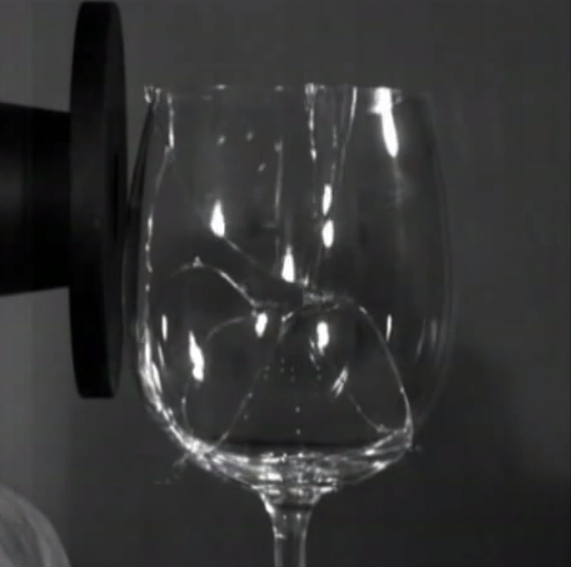
Immersion Part 1: Breaking Glass with Sound
Notes:
Facilitator Notes:
This slide will give participants a common experience for the phenomenon that anchors the immersion activity.
After participants watch the video alone, they then turn and talk with a neighbor and the video is replayed.
The video URLs hyperlinked in this video are:
Singer Shattering Glass: https://www.youtube.com/watch?v=10lWpHyN0Ok
Slow motion view of a glass shattering: https://www.youtube.com/watch?v=dU0OqVDl7kc
Talking Points:
Let’s put on our fourth grade student hats as we all experience this phenomenon.
Do not write anything down. At this point, just focus on making detailed observations in your head.
After you watch the video clips, you will have time to turn and talk with a neighbor about your observations, and then I will replay the video during that time. [Note to facilitator: Play the videos once. Then allow time for participants to discuss their observations with a neighbor. Play the videos a second time. The next slide has questions that the groups can discuss after watching the videos a second time.]

Slide 17
Phenomenon
What did you see and hear?
What happens at the beginning, middle, and end?
Immersion – Part 1
Notes:
Talking Points:
Think about what you saw and heard in the video. Think about what happened at the beginning, the middle, and the end.
In your group, discuss your answers to the two questions posted on the slide. Remember to think about this from the perspective of a fourth grader! [Note to facilitator: Give groups a few minutes to discuss their observations.]

Slide 18
Observation Chart
Observations | Initial Ideas and Hypotheses
Immersion – Part 1
Notes:
Facilitator Notes:
As groups share their observations with the whole room, record their observations in the first column in the chart on this slide so that everyone can see it. If the groups have internet access, you can set up a google document where everyone can type in their observations. If it is not convenient to type into this table, you can record their observations on chart paper or a white board.
Participants will need blank paper and pens.
Talking Points:
Let’s have each group share some of their observations. [Note to facilitator: Go around to each group and ask each one to share 2-3 observations. Make sure to ask every group, and depending on the number of groups you have, you may go back around again to ask for additional observations. Record observations on this slide (in the first column titled “observations” or on chart paper as participants share them.]
Take a blank piece of paper and create a two column chart like the one on this slide. With one column labeled “observations” and the other column labeled “initial ideas and hypotheses.”
Pick one of the initial observations that we recorded on the list. Write it down in the observations column on your piece of paper.

Slide 19
Phenomenon
Think about your observation. Think about what you think caused it to happen.
Talk with a table partner about your observation. Use the following stems in your discussion.
I chose the observation…
I think this happened because…
I think the singer has to _______ because…
Immersion – Part 1
Notes:
Talking Points:
Think about the observation that you just recorded on your paper. Take a few minutes to think about what caused it to happen and record your thoughts on the second column titled “initial ideas and hypotheses” in your paper. [Note to facilitator: Give students a few minutes to quietly think about this on their own.]
Talk to a neighbor about the observation and what you think caused it to happen. Use the sentence stems in your discussion with your neighbor.

Slide 20
Initial Ideas
Choose another observation and think about what caused this to happen.
What do you predict if the singer is farther away? Or didn’t sing as loud?
What happened here?
Turn to a partner and share your observations and ideas.
Immersion – Part 1
Notes:
Facilitator Notes:
You will need to go back to slide 17 so that students can see the list of observations and choose another observation.
Talking Points:
[Note to facilitator: If you recorded the class observations on the slide, go back to slide 19 so that students can see the list of observations and choose another observation. Then, come back to this slide.]
Choose another observation from the list and think about what caused that to happen. Record your observation and thoughts on your paper. Also think about and record your thoughts about the following questions: What do you predict if the singer is farther away? Or didn’t sing as loud? What happened here? [Note to facilitator: Give students a few minutes to quietly think about this on their own.]
Share your thoughts with a partner. [Note to facilitator: Give everyone a few minutes to discuss their ideas.]
[Note to facilitator: Go back to slide 17 as students are discussing their thoughts with a partner. You will be asking participants to share out and will record their initial ideas and hypotheses in the second column in slide 17.] Let’s go back to our observation chart and record some of your initial thoughts and hypotheses. [Note to facilitator: Ask for volunteers to share their ideas or pick on pairs.]

Slide 21
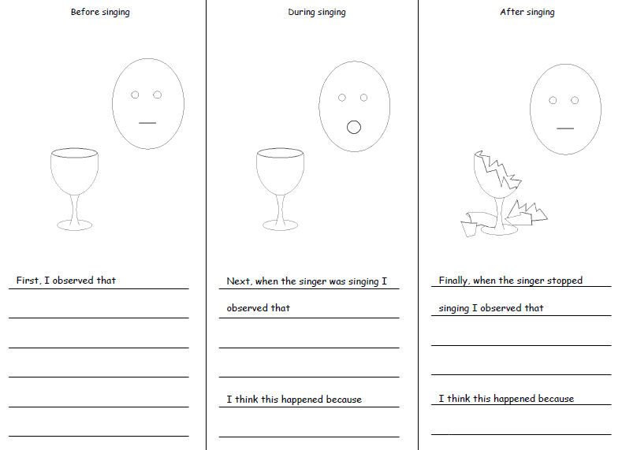
Model Sheet
Complete the model handout
Record your thinking for before, during, and after the glass shattered
Record your questions and wonderings on the back of your model
Immersion – Part 1
Notes:
Facilitator Notes:
Participants will need a copy of Handout 2 – Immersion Student Packet. Participants will be working on the first page of this handout. This page will be referred to as the ”Initial Model” and it has three columns: “before singing,” “during singing,” and “after singing.”
Direct participants to use their Initial Model handout to record (both by writing and drawing) the things that they think are happening that they can’t see. Students can talk to their partners about their ideas, but each participant should complete a model sheet to show their own thinking.
Circulate to help struggling participants.
After participants have time to record their observations, collect the handouts as you will be sharing a few examples. Select a variety of different models to share with the group, and be sure to select a model to share that has vibrations as this will lead into the next lesson. The idea is not to correct flaws at this point, but just to have the “students” share out there ideas.
The purpose of this handout is not to evaluate or correct student ideas, but is rather to see what students’ initial ideas are and how they are approaching the phenomenon.
The paper icon seen on this slide, will be used throughout the professional learning to indicate when participants will be using a handout.
The pencil icon seen on this slide, will be used throughout the professional learning to indicate when participants should be recording their ideas.
Talking Points:
Take out your copy of the Immersion Student Packet. We will be working on the first page of this packet. The page will be referred to as the “Initial Model” and it has three columns: “before singing,” “during singing,” and “after singing.” A screenshot of the page is on the slide
For each stage, write down and draw what you think is happening that you cannot see. If you have any questions, write those down on the back of the paper. [Note to facilitator: Give participants 5-10 minutes to work on their handout. After participants have had time to record their observations, collect and share a few examples.]
Let’s look at a few examples of the handout that you just filled out. What do you notice about the different models we observed? What are some of the similarities and differences? [Note to facilitator: Ask some participants to share their drawings and questions with the entire class. As participants share their models, keep an eye out for any models that show show drawings for or questions about vibrations, as you will be using those models in the next part of the activity during slide 22.]

Slide 22
Sharing
What questions do you have about the singer breaking the glass?
What are some of the things you are not sure about?
What kinds of experiences do we need to learn more about?
What are some ways we could test our hypotheses?
Immersion – Part 1
Notes:
Facilitator Notes:
Use the questions on this slide to begin and guide a whole group discussion that will wrap up this section of the activity. (This immersion activity is adapted from lessons by the Ambitious Science Teaching Framework. In their storyline, this is the end of the first lesson for students.)
Allow participants time to think about the listed questions quietly and then provide some time for them share out to the class.
It may be easier to guide the discussion by having participants share out their answers by each question. To help guide this discussion, animated arrows that point to each question and that are advanced by clicking the mouse button, are included in this slide. The first click makes an arrow appear for the first question, and the second click makes the first arrow disappear. This is repeated for the remaining three questions.
For the class discussion, it may be helpful to write down participants’ ideas on chart paper.
In this discussion, challenge participants to be honest about things that they are still not sure about. Remind participants to think as fourth graders!
Talking Points:
After sharing ideas with your peers and completing your initial model sheet, what questions do you have about the singer breaking the glass? What are some of the things you are not sure about? What kinds of experiences do we need to learn more about? What are some ways we could test our hypotheses?
[Note to facilitator: Read out all of the questions on the slide. Provide a few minutes for participants to quietly and individually reflect on these questions and then lead a whole group discussion.]
Take a few minutes to re-read the questions on the slide and think about your answers. Then we will share out as a whole group. [Note to facilitator: It may be easier to guide the discussion by having participants share out their answers by each question. To help guide this discussion, animated arrows that point to each question and that are advanced by clicking the mouse button, are included in this slide. It may also be helpful to write down participants’ answers on chart paper.]

Slide 23
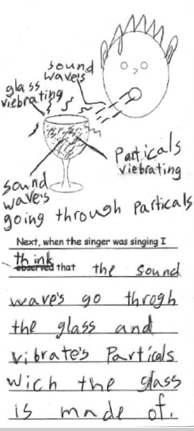
Immersion Part 2: Vibrations
Our focus question:
How do we make different sounds with our voices?
Immersion – Part 2
Notes:
Facilitator Notes:
This immersion activity is adapted from lessons by the Ambitious Science Teaching Framework. In their storyline, this begins the second lesson and their student objectives for this lesson are:
Describe and discuss patterns in the vibrations they observed.
Draw conclusions about the relationship between vibrations and volume.
Pick out some of the student work for the Initial Model handout that showed drawings for or questions about vibrations.
Talking Points:
We now are going to move into the second lesson of this unit. You will continue to play the role of a fourth grade student.
In the previous activity, you created models to show what was going on before, during, and after the singing. Here are some of the models that you created. [Note to facilitator: Share the student models that include vibrations. Either project them or pass them around. An example of student work that shows vibrations is shown as an image on this slide and can be used as an example to anchor the focus question if participants’ models are difficult to project/display.]
Some of your models showed that there were vibrations during the singing. We use vibrations to make sounds when we talk, sing, whisper, etc.
We are going to explore vibrations and our focus question for today is “how do we make different sounds with our voices?”

Slide 24
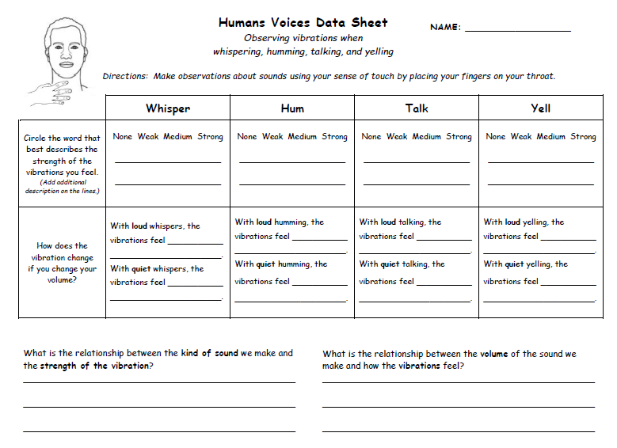
Human Voice
Complete the “Human Voices” activity
Record your observations and thinking
Immersion – Part 2
Notes:
Facilitator Notes:
Participants will need Handout 2 – Immersion Student Packet. Participants will be working on the second worksheet of this packet. The worksheet is titled Human Voices Data Sheet.
Participants will complete the worksheet by following the directions in the handout.
After participants complete the worksheet, have a class discussion about the patterns that they noticed.
Talking Points:
Turn to the second page of your Immersion packet. This page is titled Human Voices Data Sheet and a screen shot of the page is on the slide.
You will work with your group to complete the worksheet. You will follow the directions that are provided on the worksheet.
Take a minute to read through the directions on the worksheet. What observations will you be making for this activity? How will you measure or record these observations?
Remember to think as a fourth grader! [Note to facilitator: Give participants 10 minutes to complete this activity.]
Once you have collected your data, in your groups, discuss the patterns you noticed in your data. [Note to facilitator: Give participants a few minutes to discuss the patterns in their groups. Groups will share out in a whole class discussion in the next slide.]

Slide 25
Summary Table
Activity | Observations & Patterns | What did we learn? | Connection to Singer?
Human Voices: Vibrations & Sounds when whispering, humming, talking, yelling
Immersion – Part 2
Notes:
Facilitator Notes:
This summary table will help guide the next few whole group discussions to help wrap up the immersion activity.
The conversation bubble icon indicates that the participants will only be discussing the first column at this time. The grayed out columns will be discussed in the next few slides.
Talking Points:
Let’s share out your observations and the patterns you noticed in the data from the human voice activity. [Note to facilitator: Ask participants to share what they observed when they were in the process of collecting their data and what patterns they noticed in the data. You can write down their contributions on this slide or on chart paper.]

Slide 26
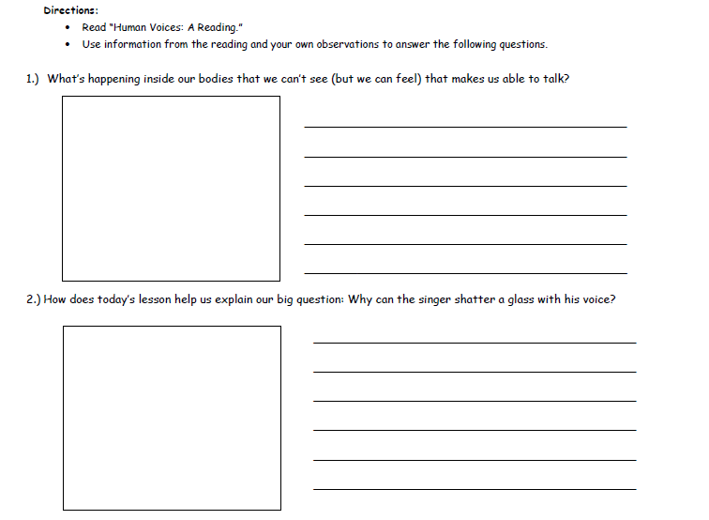
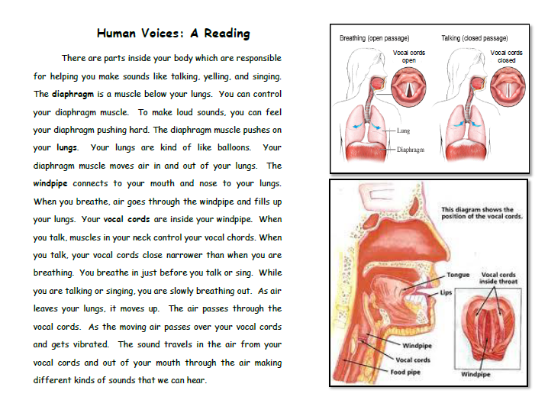
Human Voices: A Reading
What’s happening inside our bodies that we can’t see (but can feel) that makes us able to talk?
How does today’s lesson help us explain our big question: Why can the singer shatter a class with his voice?
Immersion – Part 2
Notes:
Facilitator Notes:
Participants will need Handout 2 – Immersion Student Packet. They will be using the third and fourth pages in this packet titled Human Voices: A Reading.
Talking Points:
We will begin to answer some of the questions you may have by reading a bit about how our bodies make sound.
Turn to page 3 in your Immersion Student Packet. This page is titled Human Voices: A Reading. A screenshot of the handout is on the slide.
Read through this handout. As you read, look for information to help make sense of what we felt and experienced during the Human Voice Investigation. Think about the two questions that are listed on this slide as you read: What is happening inside our bodies that we can’t see (but can feel) that makes us able to talk? How does today’s lesson help us explain our big question: Why can the singer shatter a class with his voice? Then, record your answers to these questions in the space provided on the page after your reading. You should use a combination of drawing and writing to represent your thoughts. [Note to facilitator: Give participants ~5 minutes to complete this activity. Students can work in their groups to discuss the reading and their thoughts, but each student should record their own answers to the questions.]

Slide 27
Summary Table
Activity | Observations & Patterns | What did we learn? | Connection to Singer?
Human Voices: Vibrations & Sounds when whispering, humming, talking, yelling
Immersion – Part 2
Notes:
Facilitator Notes:
This summary table will help guide a whole group discussion to wrap up the immersion activity. Remind participants to keep their student hats on for this discussion!
The conversation bubble icon indicates that the participants will be discussing the second and third columns at this time. The first column was discussed in slide 26.
Talking Points:
Now that you have read a little about how your bodies make sound, let’s discuss what you learned. What have you learned about the focus question for this lesson? Our focus question was: “How do we make different sounds with our voices?” [Note to facilitator: Ask participants to share what they have learned so far about the focus question. You can write down their contributions on this slide or on chart paper.]
How did what you learned about help us explain the phenomenon? How can we connect what we have learned back to the singer and what happened in the video? [Note to facilitator: You can write down their contributions on this slide or on chart paper.]

Slide 28
Immersion Activity: Teacher Perspective
Notes:
Facilitator Notes:
The participants will now switch over and wear the teacher hat for the immersion debrief from a teacher’s perspective. Participants will receive a packet that provides them with additional information about the unit and examples of completed student work by real fourth grade students. Participants only engaged in a portion of the unit (and that was also slightly modified), so they will receive basic information about the unit storyline to see what comes before and after the activities they did. Using their experience as students and the additional teacher information provided, participants will look for evidence for the three dimensions, and in doing so, will learn how to use the NGSS Appendices to look for evidence at the element level for all three dimensions.
Talking Points:
You participated in an immersion activity as fourth grade students. Because of our time constraints, you were not able to go through the entire unit, and instead, we focused on a few activities from the unit. Before we go back through the activities and look for evidence for three-dimensional learning, it will be helpful to see more information about the unit.
Let’s put our teacher hat on now and look at the entire unit from an educator’s point of view.
We will look at a few examples of student work and get some more details about the overall unit, so that you have more sources in which to find evidence.

Slide 29
Sample Observation & Hypothesis Chart
Observations | Initial Ideas and Hypotheses
Singer flicks glass and glass makes a sound. Singer sings the same note the whole time. Singer is really loud. Glass breaks outward then explodes. Singer takes a deep breath before singing. | The sound made the glass break. The sound has to be loud and close to the glass. The vibrations made the glass shatter. The singer has enough air to make it happen.
Notes:
Facilitator Notes:
In Slide 17, you filled out a chart during a class share-out of participants’ observations and initial ideas and hypotheses. The chart on this slide is a sample of what the chart would look like if it was filled out by observations and ideas from fourth grade students. It is included to help participants see what type of observations and ideas actual fourth grade students may have.
Talking Points:
In the immersion activity, you shared your observations, ideas, and hypotheses during a class discussion and we recorded them on a chart. The chart on this slide is an example of what some observations and ideas from fourth grade students may look like.
[Note to facilitator: Give participants a few minutes to look over this chart.]

Slide 30
Example of a Completed Summary Table
Notes:
Facilitator Notes:
Participants will need a copy of Handout 3 – Immersion Teacher Packet. They will be looking at page 1 in the packet.
In the second part of the immersion activity, you filled out a summary table with the participants. The table on this slide is an example of a completed summary table that has examples from fourth grade students. In the actual fourth grade unit, this chart is revised as the students progress through the unit and they continue to add evidence to their models of how the singer broke the glass.
Talking Points:
Please pull out your copy of the Immersion Teacher Packet.
One the first page, there is an example of a completed summary table that we filled out during the second part of the immersion activity. This has examples from fourth grade students. As students progress through the actual unit, this chart is revised and they continue to add evidence to their models of how the singer broke the glass.
[Note to facilitator: Give participants a few minutes to look over this table.]

Slide 31
Storyline for the Unit on Sound
Anchor Phenomena: Singer shattering glass with his voice
Driving Question: Why was the singer able to shatter the glass?
Question | Phenomena | Science & Engineering Practices | The Science Ideas & Questions We Figured Out
How do we make different sounds with our voices? | Vibrations when whispering, humming, talking, and yelling | Plan and carry out an investigation Analyzing data Obtaining and communicating information | Vibrations can travel through the air from the source of the sound to another object and effect that object. Vibrations diminish over a distance.
What happens to the volume of a sound as we increase our distance? | Sounds from an horn have a lower decibel reading the further away from the source | Plan and carry out an investigation Analyze and interpret data | Vibrations diminish over a distance. Loudness diminishes over a distance.
How does the force of vibrations affect the volume of the sound? | Hitting and tapping a tuning fork and putting it in water. | Plan and carry out investigations | Vibrations “cause” sound that we can hear. The harder the force to begin the vibration, the louder the sound and the more energy it has. (wave amplitude represents volume)
How do you think the sound from my mouth gets to your ears so you can hear me? | Sounds made by listening to sounds through a table and through the air by soft and hard knocking. | Plan and carry out an investigation Develop and use a models Analyze and interpret data | Matter is made up of particles. Particles in gases are farther apart than particles in solids. Sound energy transfers through matter by bumping particles.
Why can we hear outside noises when we are inside the classroom? | Variation in decibels in closed and open boxes. | Plan and carry out an investigation Analyze and interpret data Obtain, evaluate and communicate information | As it moves through matter, sound energy can be reflected (echo) or absorbed (muffled). The material/matter causes one of the other to happen.
How can one object make another object vibrate without touching it? | Humming bowl and “twin” tuning forks | Plan and carry out and investigation Analyze and interpret data Develop and use models | Vibrating things make sounds and also sounds can make things vibrate if they are “twins.” (Also sound energy does not blow air but moves through it by bumping)
Notes:
Facilitator Notes:
Participants will need a copy of Handout 3 – Immersion Teacher Packet. They will be looking at page 2 in the packet.
This is a basic storyline that shows the lesson-level questions and phenomena for the entire unit.
Talking Points:
On the second page of the Immersion Teacher Packet, you will find the storyline table for the entire unit as seen on the slide. We just participated in the first section of the unit, but the unit continues to provide opportunities for students to build their explanations of the phenomenon.
There are many ways to represent a storyline for a unit, and this table shows you one way it can be done.
This storyline provides you with the anchor phenomenon and the driving question for the entire unit. It also lists the questions and investigative phenomena for the individual lessons of the unit. It provides information about the practices that students will be engaged in for each lesson, along with the science ideas and questions that students figure out in each lesson.
Take a few minutes to read through the storyline. [Note to facilitator: Give participants a few minutes to look over the storyline.]

Slide 32
A Graphic Representation of Coherence
Goal: Why was the singer able to shatter the glass?
Anchoring phenomena
Phenomena-driven Questions
Investigate and build knowledge through practices and crosscutting concepts
Incrementally Build Explanations, Models, or Designs OR What we figured out
Human Voice Vibrations
SEP, DCI, CCC
Initial explanation, model or design
Decibels at a Distance
SEP, DCI, CCC
Add to/revise
“Seeing” the Sound Waves
SEP, DCI, CCC
Add to/revise
Sound Traveling Through Matter
SEP, DCI, CCC
Add to/revise
Absorbing and Reflecting Sound
SEP, DCI, CCC
Add to/revise
. . .
Resonance
SEP, DCI, CCC
Final consensus explanation, model or design
Notes:
Facilitator Notes:
Participants will need a copy of Handout 3 – Immersion Teacher Packet. They will be looking at page 3 in the packet.
Talking Points:
On this slide and on the third page of the Immersion Teacher Packet, you will find the another way to represent the unit storyline: a coherence map for the unit.
The coherence map shows that the unit begins with the anchoring phenomenon and the driving question of “why was the singer able to shatter the glass?” Each line in this graphic represents a lesson, and requires students to integrate all three dimensions to build and revise their models and explanations of the overall anchor phenomenon. As students proceed through the unit, they revise their explanations and model in each lesson based on what they have learned in that lesson. This then leads them to the next lesson, where they repeat the process, until they create their final explanation and model at the end of the unit. The coherence map shows that each activity serves an explicit purpose in the unit, and contributes toward students understanding and explaining the anchor phenomenon.
[Note to facilitator: Give participants a few minutes to look over the coherence map.]

Slide 33
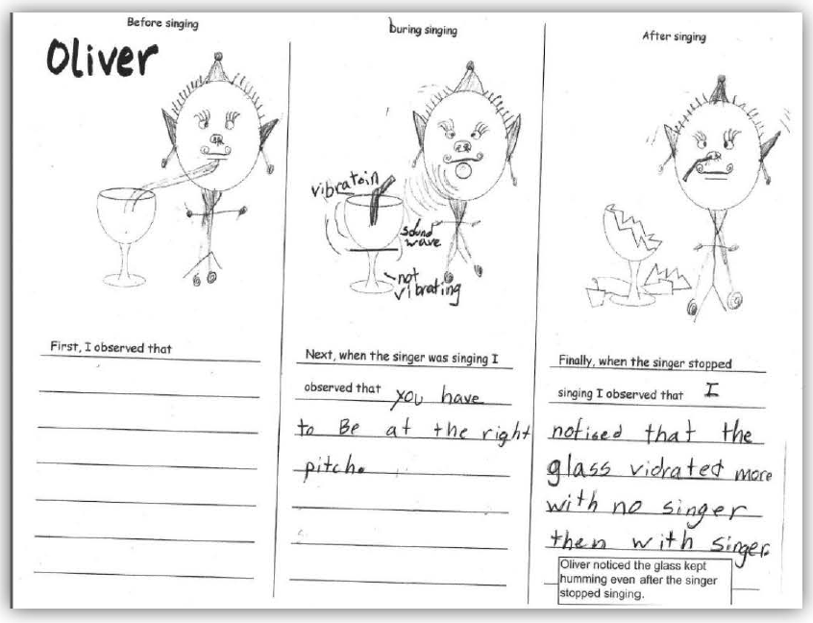
Example of Student Work
How did the students’ models change over time?
What misconceptions do you see students have in their final models?
Do you see evidence of students engaging in three-dimensional learning?
Notes:
Facilitator Notes:
Participants will need a copy of Handout 3 – Immersion Teacher Packet. They will be looking at pages 4-6 in the packet.
Pages 4-6 in the Immersion Teacher Packet represent student models. Page 4 has two students’ initial models that they created toward the beginning of the unit (similar to how the participants’ created their initial models). Pages 5-6 show the final models for the same students. Participants will be able to see how students’ thinking changed over the course of the unit by comparing the initial and final models.
Participants will be asked if they see evidence of students engaging in three-dimensional learning in this slide and the next slide. This is an opportunity for you to walk around and listen to participants’ discussions to see what they think three-dimensional is and what misconceptions they may have. Take a mental note of what they are saying, because in a few slides (slide 34) you will begin the three-dimensional learning section and where you can clear up any misconceptions.
Talking Points:
Let’s also look at some student examples of initial and final models.
In pages 4 through 6 of your packet, will find the initial and final models created by Marianna and Oliver. The initial models for both are on page 4 and the final models are on pages 5-6. Take a few minutes to look over the student work samples.
As a table discuss the following questions:
How did the students’ models change over time?
What misconceptions do you see students have in their final models?
Do you see evidence of students engaging in three dimensional learning (SEPs, CCCs, & DCIs)? [Note to facilitator: This is an opportunity for you to walk around and listen to participants’ discussions to see what they think three-dimensional is and what misconceptions they may have. Take a mental note of what they are saying, because in a few slides (slide 34) you will begin the three-dimensional learning section and where you can clear up any misconceptions.]

Slide 34
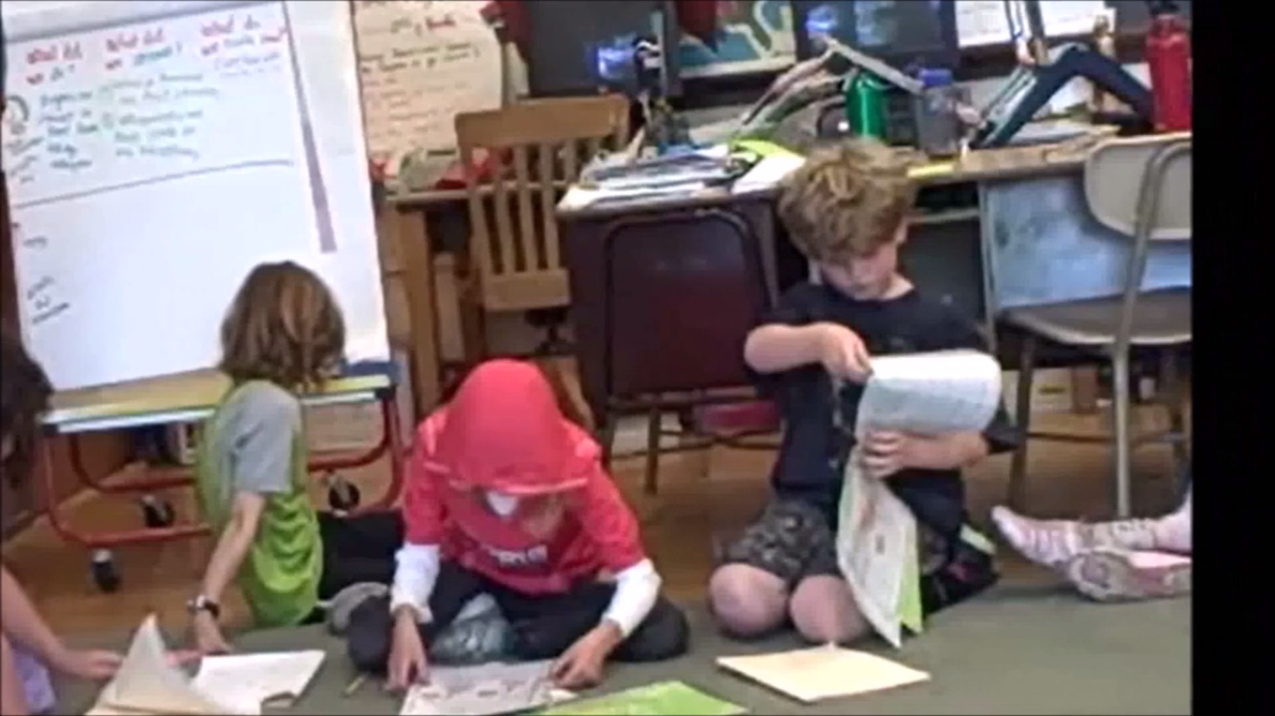
Discussion in a 3rd Grade Classroom
Notes:
Facilitator Notes:
The hyperlink for the video in this slide is: https://vimeo.com/126093889
Note: The sound in the video is low. Be sure to turn the volume up
This video shows third grade students engaging in the same activities that the participants were engaged in during the immersion.
Participants will be asked if they see evidence of students engaging in three-dimensional learning in this slide. This is an opportunity for you to walk around and listen to participants’ discussions to see what they think three-dimensional is and what misconceptions they may have. Take a mental note of what they are saying, because in the next slide, you will begin the three-dimensional learning section and where you can clear up any misconceptions.
Talking Points:
Finally, let’s watch a video of third grade students engaging in the same activities that we did.
As you watch the video think about three dimensional learning. What evidence do you see of students engaging with each of the three dimensions: the SEPs, CCCs, & DCIs? [Note to facilitator: This is an opportunity for you to walk around and listen to participants’ discussions to see what they think three-dimensional is and what misconceptions they may have. Take a mental note of what they are saying, because in a few slides (slide 34) you will begin the three-dimensional learning section and where you can clear up any misconceptions.]

Slide 35
Three-Dimensional Learning
Notes:
Facilitator Notes:
Three-dimensional learning is an important concept for participants to understand, as it is one of the NGSS Innovations, and participants will be looking for evidence that it is occurring in the materials they will be evaluating in the prescreen process. This section helps build participants’ understanding of three-dimensional learning by discussing what it means, and the next section (Looking for Evidence of the Three Dimensions) will guide participants through finding evidence for each of the three dimensions. By the time participants are ready to look at the PEEC Prescreen tools later on in this presentation, they will already have begun to build an understanding of the criteria that the tools use. Participants’ will continue to build their understanding of three-dimensional learning when the related prescreen tools are introduced.
Since participants are expected to have a basic understanding of the NGSS, this section may seem to not be necessary for your group if they are well-versed in the NGSS. However, it can help bring all participants to the same level of understanding and the group discussions can ensure that participants are thinking about three-dimensional learning in the same way. This leveling is important as three-dimensional learning criteria will appear in all three phases of the PEEC process.

Slide 36
Three-Dimensional Learning
What is three-dimensional learning?
What does it mean to you?
As students in the immersion activity, were you engaged in three-dimensional learning? At what point? How do you know?
Notes:
Facilitator Notes:
As participants have a discussion with the partners about the questions posted on the slide, walk around the room and listen to their thoughts. If participants are struggling to answer the questions, this will help you understand what misconceptions you need to clear, or on the other hand if participants are demonstrating a solid understanding, you can proceed through this section relatively quickly. You will be using the ideas that participants share during the discussion to transition to the next slide.
Talking Points:
We have tossed around the words ”three-dimensional learning” a few times. Think about the following questions and share your thoughts with a partner:
What is three-dimensional learning?
What does it mean to you?
As students in the immersion activity, were you engaged in three-dimensional learning? At what point? How do you know?
Take a few minutes to discuss these questions with a partner at your table. [Note to facilitator: Give participants a few minutes to discuss their thoughts.]
Who would like to share their ideas with the whole group? [Note to facilitator: Ask a few participants to share their thoughts about what three-dimensional learning is with the entire group.]

Slide 37
“Learning About” vs. “Figuring Out”
Students figure out phenomena and build their explanations
Students learn about facts and details
Notes:
Facilitator Notes:
Use the ideas that participants shared in the previous slide to transition into talking about learning about vs figuring out. Alter the talking points in this slide to build upon the conversation that began with your group in the last slide.
Talking Points:
An important idea that was shared about three-dimensional learning was that students are building explanations.
In an NGSS classroom, the focus shifts from simply learning about science ideas that students often have difficulty applying to real-world contexts to figuring out or making sense of phenomena in the world that students are motivated to explain.
Students are not just learning about a topic, but they are now figuring out why or how something happens in the world.
Students can then use these explanations to make sense of new contexts and transfer this working knowledge to new situations.
If students are not being fed the information, how are they gathering information and building their explanations or designing solutions to problems? What should they be engaged in during the lesson? [Note to facilitator: You want the participants to say that students need to be engaged in the three dimensions during the lesson – the practices, disciplinary core ideas, and crosscutting concepts. If participants are not getting to that idea, ask them what the rest of three-dimensional learning is and strongly hint them toward the three dimensions.]
Yes! Students build this working knowledge by engaging through the practices, by using the crosscutting concepts to organize and connect thinking, and by using the disciplinary core ideas to explain their world and develop solutions to problems.
Figuring out or making sense of phenomena supports three-dimensional learning.

Slide 38
What is Three-Dimensional Learning?
Students use
core ideas + crosscutting concepts + practices
to explain how and why phenomena occur or to design solutions to problems
Practices
Core Ideas
Crosscutting Concepts
Notes:
Facilitator Notes:
The important take-away in this slide is that participants should understand that in three-dimensional learning students are the ones that should be developing and using the three dimensions to explain a phenomenon or to design a solution to a problem. Often, a lesson or activity will show evidence that a teacher is using the three dimensions, but that does not ensure that students will develop or use the dimensions. The emphasis on students and finding evidence in lessons that students are the ones developing and using elements of dimensions can be found throughout the professional learning sessions.
Talking Points:
If we take our discussion about three-dimensional learning and create a definition for three-dimensional learning we can sum it up by saying: students use core ideas, crosscutting concepts, and practices to explain how and why phenomena occur or to design solutions to problems.
Notice the emphasis on the word “students.” It is important to remember that students and not teachers should be the ones developing and using the three dimensions to explain a phenomenon or to design a solution to a problem. Remember that three-dimensional learning shifts the focus of the science classroom to students.

Slide 39
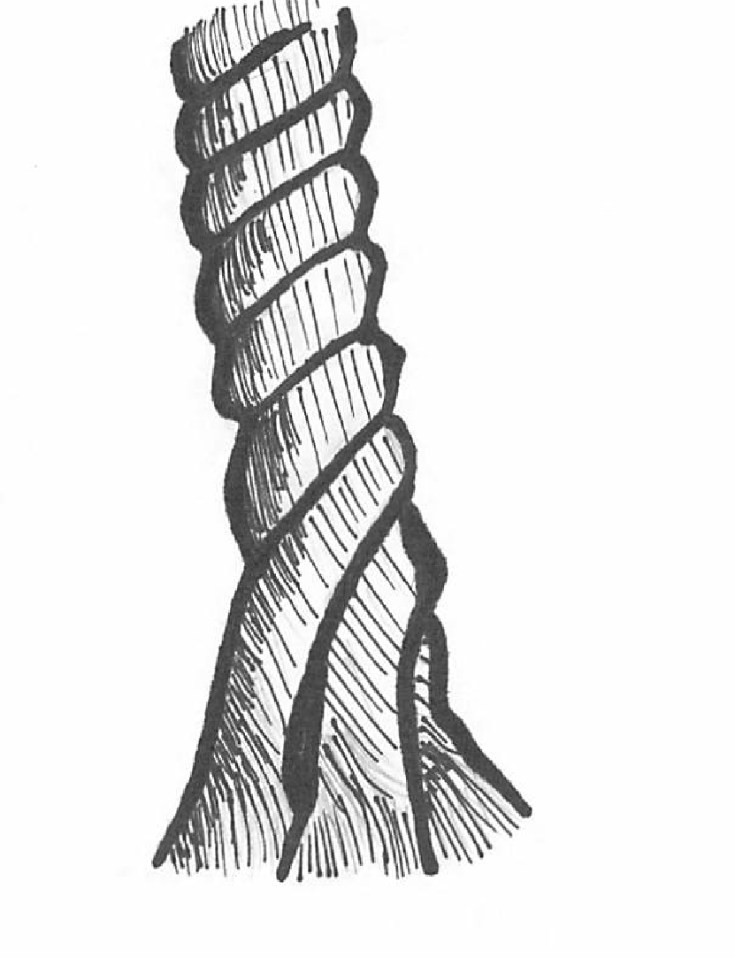
What Does Three-Dimensional Learning Look Like?
Crosscutting
Concepts
Core Ideas
Practices
Notes:
Facilitator Notes:
Some participants may think that as long as the three-dimensions are present in a lesson, that the lesson is three-dimensional. However, it is important for them to understand that the three dimensions need to work together and that student performances need to show students engaged in all three at the same time to explain a phenomenon or design a solution to a problem. The analogies in the next few slides will help to reinforce this idea.
Talking Points:
So what does three-dimensional learning look like in the classroom?
The key with three-dimensional learning is that engagement in the dimensions cannot occur in isolation of each other. The three dimensions need to work together and students need to be engaged in all three at the same time. For example, students should not only be engaged in practices at the beginning of the lesson, disciplinary core ideas in the middle, and then crosscutting concepts at the end.
Think of the three components of three-dimensional learning as three intertwining stands of a rope. While the rope can be separated into its three different strands, the strength of the rope is determined by the strands working together; separating the strands weakens the rope so that it is no longer effective for our intended use.
While in the past we may have separated out the knowledge and skills students need in the study of science, in actuality, knowing and doing cannot be separated if our goal is the kind of usable, conceptual understanding students need to think, act, and learn like scientists.
Three-dimensional learning—practices, core ideas, and crosscutting concepts working together—is therefore a non-negotiable for NGSS lessons and units.

Slide 40
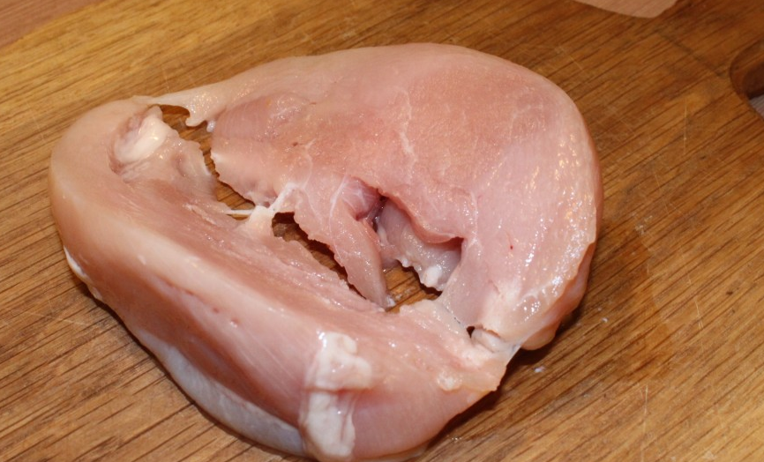
Three-Dimensional Learning Analogy
How is Three-Dimensional Learning like making a really great meal?
The main ingredients are the core ideas.
The cooking techniques are the practices.
The herbs and spices are the crosscutting concepts.
Notes:
Facilitator Notes:
Participants often find hearing and creating an analogy helpful in strengthening their understanding of three-dimensional learning. They will receive an opportunity to create their own analogy in the next slide.
Talking Points:
Borrowing an idea from Ted Willard at NSTA, Joe often compares three-dimensional learning to making a really good meal.
As Joe says so well, “Think of knowing how to do various techniques in the kitchen like kneading bread, cutting tomatoes, beating an egg, frying or roasting, and so forth as the practices. You could know how to do all of these things and still not be able to prepare a really good meal.”
“Now think of picking out really good ingredients for the meal. You want to pick out a high-quality piece of fish or poultry or excellent pasta for the meal. These are your core ideas. A disciplinary core idea is essential to explaining a number of phenomena. Your main ingredient is essential to the meal. But just as the [disciplinary core idea] works with practices to make sense of phenomena and design solutions, you need to know how to cook that main ingredient. But something is still missing. The meal tastes bland. What is missing? To make a really good meal, we need to use spices and herbs to enhance the flavor of the main ingredients.”
“Crosscutting concepts are like these spices and herbs—they enhance learning by providing a familiar lens to use to examine and understand phenomena. Because the same spices and herbs are used in many different dishes, we recognize them even when we have them in a new or unfamiliar dish. Consequently, we can use our familiarity with a spice or herb to examine a new meal and understand what was used to make it. Likewise, crosscutting concepts can be found in all scientific disciplines, and we can use our familiarity with crosscutting concepts in one discipline of science to examine phenomena and enhance understanding and learning in other disciplines of science.”
“To make a really wonderful meal, good main ingredients are necessary, but you need to know how to use various techniques to prepare them, and you must have the spices and herbs to enhance the flavors. All three work and blend together to make a great meal. Similarly, to foster three-dimensional learning where all learners can make sense of phenomena and design solutions, all three dimensions need to work and blend together” (http://nstacommunities.org/blog/2014/04/25/equip/).

Slide 41
Create Your Own Analogy
Three-Dimensional Learning is like _________:
Where _______________ are the Practices;
_______________ are the Core Ideas; and
_______________ are the Crosscutting Concepts.
Notes:
Facilitator Notes:
Participants often find hearing and creating an analogy helpful in strengthening their understanding of three-dimensional learning.
If you find that the participants already have a strong understanding of three-dimensional learning and do not need to create their own analogies, feel free to skip this slide.
Talking Points:
Now, take a few minutes and create your own analogy for three-dimensional learning.
[Note to facilitator: Ask participants to share their analogies and explanations with their table group or the whole group.]
Does anyone have any questions about three-dimensional learning? [Note to facilitator: The next section moves on to talking about how to look for evidence of the dimensions, so this would be a good place to address any lingering questions about three-dimensional learning.]

Slide 42
Looking for Evidence of the Three Dimensions
Notes:
Facilitator Notes:
Using their experience as students and the additional teacher information provided, participants will look for evidence for the three dimensions in the immersion activity, and in doing so, will learn how to use the NGSS Appendices to look for evidence at the element level for all three dimensions.
Talking Points:
Now that we have experienced the immersion activity as a student, have received more information about it from the teacher perspective, and have discussed what three-dimensional learning is, let’s look for evidence of three-dimensional learning.
When we look for evidence of three-dimensional learning, it is easier to break it down slightly and to first look for the evidence that each of the three dimensions are present, and then look for evidence to see if those dimensions are integrated and working together.
For the immersion activity, we will look for evidence that each of the three dimensions are present.

Slide 43
Evidence
Are practices, core ideas and crosscutting concepts present in the lesson?
AND
What’s your evidence for saying the dimensions were present?
Notes:
Facilitator Notes:
This slide is meant to elicit what the participants’ think evidence is. The explicitness of evidence required in the PEEC process will be discussed in a few slides.
Talking Points:
When we look to see if the three dimensions are present in the immersion activity, we are looking to answer three separate questions: Are science and engineering practices present? Are disciplinary core ideas present? Are crosscutting concepts present?
If you say that a particular dimension is present in the lesson, you need evidence to support your ”yes.”
If you are asked to look for evidence of the three dimensions in a lesson, what would you look for? What would your evidence be? Take a few minutes to discuss this with your group. [Note to facilitator: Give participants a few minutes to discuss how they would look for evidence of the three dimensions in a lesson.]

Slide 44
Evidence of the Dimensions
Evidence is visible: you can see it, point to it in a lesson or unit, highlight it, or quote it directly from what is written.
Notes:
Facilitator Notes:
It is extremely important that participants understand that evidence needs to be explicit and visible. It is often easy to think about the lessons as an educator, see the potential in a lesson, and then assume that there is evidence there because there is potential for students to do something. However, directions need to be explicitly written that show that all students will be engaged in a particular dimension. If directions are vague, then the assumptions of what students will do can vary by the person reading the directions. If you are reading the lesson and saying that there is a chance students “could do…” or “are probably…” or “if they added in this step, then they could…” that is not explicit evidence, it is implicit and cannot be used as evidence that something is definitely present.
While participants may show understanding of explicit evidence at this time, it is important to keep reinforcing this idea throughout the professional learning.
Talking Points:
When we discuss finding “evidence,” we need to make sure that the evidence we are using to back up our claim of whether something is present or not in a lesson is extremely explicit.
We need to be able to see the evidence, point to it, highlight it, or quote it directly from what is written.
As educators, it is extremely easy to fill in the gaps in instructions and lessons and think about what we would be able to do with a particular activity, discussion, etc. based upon just a few instructions. However, it is important to remember that not every educator will interpret general instructions in the same way, and educators will have different ways of filling in the gaps based upon their own thoughts and experiences. Therefore, if instructions are not explicitly in the lesson that show, for example, all students will be engaged in going through the detailed steps of claim, evidence, and reasoning for constructing an explanation, it is not guaranteed that all students will be engaged in constructing an explanation as called for in the NGSS practice. If at any point you think, “well this is a great place where my students could bring in looking at cause and effect,” but there are no detailed instructions in the lesson itself of students engaged in a specific cause and effect element, then that is not explicit evidence.
In general if you read a lesson and think that students “could do…” or “are probably…” or “if this step was added in, then students will be…” then there is no explicit evidence that ALL students will be engaged in that particular step and explicit evidence is not present.
We will look back over the immersion activity and see if there is evidence of each of the three dimensions.
We did not have time to look through the rest of the lessons in the unit, so we will look for evidence of each of the three dimensions in the activities you engaged in, the unit overview, the student work, and the classroom video.

Slide 45
Elements of the Dimensions
Elements are the grade-level specific bullet points that are displayed in the SEP, DCI, and CCC sections of the foundation boxes, and can be found in the NGSS appendices. They guide learning at specific grade levels.
MS-PS1 Matter and Its Interactions
Students who demonstrate understanding can: MS-PS1-5. Develop and use a model to describe how the total number of atoms does not change in a chemical reaction and thus mass is conserved. [Clarification Statement: Examples of reactions could include burning sugar or steel wool, fat reacting with sodium hydroxide, and mixing zinc with hydrogen chloride.] [Assessment Boundary: Assessment is limited to analysis of the following properties: density, melting point, boiling point, solubility, flammability, and odor.]
The performance expectations above were developed using the following elements from the NRC document A Framework for K-12 Science Education:
Science and Engineering Practices | Disciplinary Core Ideas | Crosscutting Concepts
Developing and Using Models Modeling in 6–8 builds on K–5 and progresses to developing, using and revising models to support explanations, describe, test, and predict more abstract phenomena and design systems. Develop a model to describe unobservable mechanisms. (MS-PS1-5) | PS1.B: Chemical Reactions Substances react chemically in characteristic ways. In a chemical process, the atoms that make up the original substances are regrouped into different molecules, and these new substances have different properties from those of the reactants. (MS-PS1-2), ( MS-PS1-5) The total number of each type of atom is conserved, and thus the mass does not change. (MS-PS1-5) | Energy and Matter Matter is conserved because atoms are conserved in physical and chemical processes. (MS-PS1-5)
Notes:
Facilitator Notes:
When participants are asked to look for evidence of the dimensions, it is critical that they are looking for evidence at the element level. For example, if participants are looking for evidence of the practice “developing and using models” in a middle school lesson, they may see those words and look in the lesson to see if there is any evidence that students are either developing a model or are using a model. This would not be an appropriate way to look for evidence that practices are present in a lesson. Someone may find a step where participants are developing a model, but this general search is not sufficient to know whether students are using the elements of the developing/using models practice at a grade-appropriate level. Finding general evidence that students are developing a model may in reality only show students using the practice at a K-2 grade-band level. Each practice has specific components, or elements, that students are expected to master at the end of each grade band, and these elements increase in complexity through the grade-bands. To see if the students are truly using the developing and using models practice in a middle school lesson, you need to look for evidence of the specific elements of this practice in the 6-8 grade-band. For example, you could look for evidence that students are “developing a model to describe unobservable mechanisms.”
The following copies are provided as Handout 04 – NSTA DCIs Matrix; Handout 05 – NGSS Appendix F; Handout 06 – NGSS Appendix G.
Participants will need copies of or digital access to NGSS Appendices F and G.
Participants will need a copy of or digital access to the NSTA DCIs Matrix (http://nstahosted.org/pdfs/ngss/20130509/MatrixOfDisciplinaryCoreIdeasInNGSS-May2013.pdf)
Talking Points:
When we look for evidence of the three dimensions we need to look for evidence at the element level. Let’s take a minute to define what we mean by the elements of the dimensions.
Please take a minute to read the definition of an element of dimensions that is displayed in this slide.
Every performance expectation is composed of elements from all three dimensions and the language for these elements can be found in a performance expectation’s foundation boxes. The blue box has the element for the science and engineering practices. The orange box has the elements for the disciplinary core ideas. The green box has the elements for the crosscutting concepts.
As you can see in this example, the science and engineering practice included in this performance expectation is developing and using models. This is the overall practice, and is not at the element level. So when you look for evidence, you cannot just look for general evidence that students are developing and using models. You specifically have to look for evidence that students are “developing a model to describe unobservable mechanisms.”
It is important that all of our evidence be recorded at the element level.
We can find the elements of all eight science and engineering practices in NGSS Appendix F, and the elements of all seven crosscutting concepts in NGSS Appendix G.
The elements for the DCIs are organized by grade-band in the NSTA DCIs Matrix.

Slide 46
Elements of the Dimensions
NGSS Appendix F
SEP #2 – Developing and Using Models
Notes:
Facilitator Notes:
It is important to emphasize that elements are organized by grade-band, as participants should be looking for evidence that students are engaged in grade-appropriate elements in a lesson. Sometimes, a lesson will state that it is targeting a grade-appropriate element, but the evidence will show that students are actually building an understanding of an element at a lower or at a higher grade-level.
The following copies are provided as Handout 04 – NSTA DCIs Matrix; Handout 05 – NGSS Appendix F; Handout 06 – NGSS Appendix G.
Participants will need copies of or digital access to NGSS Appendices F and G.
Participants will need a copy of or digital access to the NSTA DCIs Matrix (http://nstahosted.org/pdfs/ngss/20130509/MatrixOfDisciplinaryCoreIdeasInNGSS-May2013.pdf)
Talking Points:
Here is a chart from NGSS Appendix F that shows the elements for the science and engineering practice of developing and using models.
As you can see here, the elements are all grade-banded. There is a set of elements for K-2, a set for 3-5, a set for 6-8, and a set for 9-12.
This organization by grade-band can be seen for the practices, the crosscutting concepts, and the disciplinary core ideas.
When looking for evidence in a lesson for a particular element, you need to make sure that you know what grade band the element falls under and what grade level the lesson targets. It is possible that there is no evidence of the element at the targeted grade band, because students are engaging in the element at a higher or lower grade level.

Slide 47
Finding Evidence for DCIs
Notes:
Facilitator Notes:
Participants will focus on finding evidence of the target DCIs. Participants should look for evidence in the immersion activity they engaged in, the unit overview, the student work, and the classroom video.
Participants will need a copy of Handout 07 – Immersion Evidence Organizer.
Participants may need 8 to 10 minutes to fill out evidence for the disciplinary core ideas.
Talking Points:
Please pull out your copy of the Evidence Organizer handout.
Think back to the activity you just experienced. The designers of this unit were intentionally targeting the disciplinary core idea elements listed here on the slide and in your handout. [Note to facilitator: Click for animation.] You will look for evidence that students are using and developing these particular DCI elements in the lesson.
Look through the materials you used for the immersion activity, the student work, and the video and individually look for evidence that these DCI elements are being used and developed by students. You will have 10 minutes to individually work and then we will discuss your findings as a whole group.

Slide 48
DCIs Evidence Share Out
Take turns sharing out your ideas
Be sure to give evidence and reasoning for the disciplinary core ideas you think were present
Challenge each other’s ideas
Be prepared to share your evidence
Notes:
Facilitator Notes:
Have people share out the evidence that they recorded in the evidence organizer. The goal of this conversation is to start bringing up issues that they are likely to encounter when reviewing materials.
Possible issues that participants may encounter (the respective talking points are listed in the section below):
Expect participants to identify the fact that energy isn’t really addressed in the unit. This helps participants learn to be critical and to know that the evidence needs to be explicit.
Participants may also identify pieces of evidence that are not truly evidence and are only implied in the materials.
Participants may identify that some grade-inappropriate DCI elements are identified.
Talking Points:
Let’s discuss the evidence that you found. This slide has the guidelines for our share out. Please take a minute to read over them.
[Note to facilitator: Lead a group discussion.] How well did this lesson address the target disciplinary core ideas? Did you find evidence for DCI element PS3.A? Did you find evidence for DCI element PS4.A?
Depending on what participants bring up during the discussion, here are some specific talking points:
It’s great to think about how you could use some these materials and then modify them in your classroom, but the focus is making sure that there is explicit evidence in the materials
We may run into situations where the DCIs are out of the target grade band for the lesson. For example, PS4.A is actually in the K-2 grade band.
We may run into materials that are claiming to address DCIs, but that only address part of what is expected. Whether or not that is “okay” depends on whether or not the other portions are addressed elsewhere in the materials.

Slide 49
Crosscutting Concepts
Patterns
Cause and effect
Scale, proportion, and quantity
Systems and system models
Energy and matter
Structure and Function
Stability and Change
Notes:
Facilitator Notes:
Participants will focus on finding evidence of the target crosscutting concepts. Participants should look for evidence in the immersion activity they engaged in, the unit overview, the student work, and the classroom video.
See the facilitator note in the fourth talking point for important points to cover in your crosscutting concepts discussion.
Participants will need a copy of or digital access to NGSS Appendix G. A copy for it is provided as Handout 06 – NGSS Appendix G.
Talking Points:
The crosscutting concepts are a lens we want students to look through as they are making sense of the world around them.
We want students to not only be able to use each lens, but to be aware enough that they can change the lens for the situation—microscope; magnifying glass; glasses; binoculars; telescope.
There are seven overall crosscutting concepts, but each CCC has specific elements that can be found organized by grade band in NGSS Appendix G. Take a minute to look through some of the elements in NGSS Appendix G. [Note to facilitator: Give participants a few minutes to look through the elements in NGSS Appendix G.]
Turn and talk with a neighbor, what might evidence of the crosscutting concepts look like in instructional materials? [Note to facilitator: Give participants a few minutes to discuss the question with their partners. Then, have some participants share out their ideas. Finding evidence for crosscutting concepts can be tricky sometimes and this will be an important conversation. Many times a lesson developer will include a vague statement such as “ask the students to look for patterns.” However, without more details such as the type of questions students are asking about patterns or the types of statements they are making, just including the word “patterns” is in most situations not evidence enough that students are using a grade-appropriate element of the crosscutting concept. It is important that participants understand that simply including the words for a crosscutting concept does not mean the students are actually using that crosscutting concept. You need to read the steps that come before and after those words are used and really think if from what is written, it is guaranteed that all students will use that crosscutting concept. Also, think about it from the shoes of a student. Would a student in that situation understand that they were using a crosscutting concept? Finding evidence for crosscutting concepts often requires a little more digging than finding evidence for the other two DCIs.]

Slide 50
Crosscutting Concepts
On your evidence organizer identify elements of the crosscutting concepts that students were engaged in during the immersion experience.
Notes:
Facilitator Notes:
Participants will need a copy of or digital access to NGSS Appendix G. A copy for it is provided as Handout 06 – NGSS Appendix G.
Talking Points:
Start with the crosscutting concepts that are provided in the handout and identify whether there is evidence of these in the lesson. After recording the evidence, look through Appendix G and determine if there are other CCCs that are a part of the lesson.
Remember Where is the evidence that students are engaged in the elements of the CCCs? It is particularly important to go to the element level in evaluating the CCCs, because there will be many connections at the larger grain-size.
You will have 10 minutes to individually work and then we will discuss your findings as a group.

Slide 51
Crosscutting Concepts Share Out
Take turns sharing out your ideas
Be sure to give evidence and reasoning for the elements of the crosscutting concepts you think were present
Challenge each other’s ideas
Be prepared to share your evidence
Notes:
Facilitator Notes:
Participants will need a copy of or digital access to NGSS Appendix G. A copy for it is provided as Handout 06 – NGSS Appendix G.
Talking Points:
[Note to facilitator: Lead a group discussion by asking participants to share the evidence they found.] Let’s share some of the evidence you found for the crosscutting concepts listed on the evidence organizer.
What are some additional CCC elements that might fit well with this unit? [Note to facilitator: Participants might respond that all crosscutting concepts connect with the unit. If this happens, discuss with the group the importance of knowing which CCC to emphasize when working with students. Students need time to develop each “lens”. This happens through questions and modeling the CCCs. If all CCCs are included in a unit, it will become harder for the students to develop deeper understanding for any CCC.]

Slide 52
Science and Engineering Practices
Asking questions (for science) and defining problems (for engineering)
Developing and using models
Planning and carrying out investigations
Analyzing and interpreting data
Using mathematics and computational thinking
Constructing explanations (for science) and designing solutions (for engineering)
Engaging in argument from evidence
Obtaining, evaluating, and communicating information
Notes:
Facilitator Notes:
Participants will need a copy of or digital access to NGSS Appendix F. A copy for it is provided as Handout 05 – NGSS Appendix F.
Talking Points:
There are eight overall science and engineering practices (SEPs), but each SEP has specific elements that can be found organized by grade band in NGSS Appendix F. Take a minute to look through some of the elements in NGSS Appendix F. [Note to facilitator: Give participants a few minutes to look through the elements in NGSS Appendix F.]

Slide 53
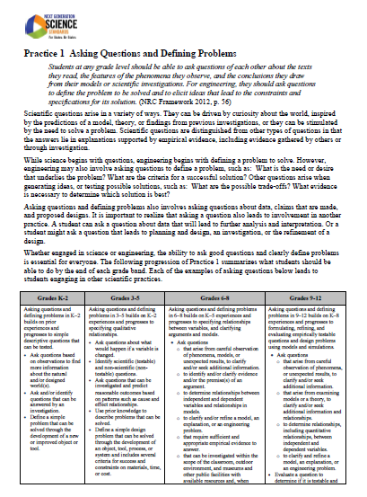
Science and Engineering Practices
On your evidence organizer, identify elements of the practices that students were engaged in during the immersion experience. Be sure to connect elements of the practices directly to evidence from the immersion.
Notes:
Facilitator Notes:
Participants will need a copy of or digital access to NGSS Appendix F. A copy for it is provided as Handout 05 – NGSS Appendix F.
As participants look for and discuss their findings, keep an ear out for anyone saying the overall practice names, instead of the specific elements. If you hear participants saying “I found evidence that students are developing and using models in step 7 when they…” ask them which element of that practice they found evidence for.
Talking Points:
Use NGSS Appendix F and look through the lesson to identify whether there is evidence for any SEP element. It is particularly important to go to the element level in evaluating the SEPs because there will be many connections at the larger grain-size.
You will have 10 minutes to individually work and then we will discuss your findings as a group.

Slide 54
Practices Share Out
Take turns sharing out your ideas.
Be sure to give evidence and reasoning for the elements of the practices you think were present.
Challenge each other’s ideas.
Be prepared to share your evidence
Notes:
Facilitator Notes:
Participants will need a copy of or digital access to NGSS Appendix F. A copy for it is provided as Handout 05 – NGSS Appendix F.
Talking Points:
Let’s share some of the evidence you found for the science and engineering practices. [Note to facilitator: Select 4-7 people to share an element of a practice and the evidence from the unit. When participants share, have them say the page of Appendix F they found the element, the practice, and then the element of the practice. This will support participants as they move on to looking for elements and evidence in curriculum materials.]

Slide 55
Lesson Debrief
Overall, do you think there is evidence for grade-appropriate elements of the…
…practices?
….disciplinary core ideas?
…crosscutting concepts?
Notes:
Facilitator Notes:
Before moving on to the next section, check in with the participants to see if they have any questions about finding evidence for the three dimensions.
Talking Points:
We just discussed the evidence you found for the practices, the disciplinary core ideas, and the crosscutting concepts.
Overall, do you think there is evidence for grade-appropriate elements of the practices?
Overall, do you think there is evidence for grade-appropriate elements of the disciplinary core ideas?
Overall, do you think there is evidence for grade-appropriate elements of the crosscutting concepts?
Do you have any questions about finding evidence for the three dimensions?

Slide 56
Phenomena
Notes:
Facilitator Notes:
This section builds participants’ understanding of NGSS Innovation One: Phenomena or Problems. It walks participants through coming up with a definition for phenomena and with the characteristics of an instructionally productive phenomenon. Important points that need to be made about phenomena are included as facilitator notes in the next few slides. Participants will continue to build their understanding of Innovation One throughout the professional learning sessions.
Talking Points:
The NGSS focus on the innovation of three-dimensional learning is critical in supporting another NGSS innovation: phenomena.
Three-dimensional learning supports students in figuring out phenomena or developing solutions to problems.
In the immersion activity that you participated in, were you focused on trying to explain something or develop a solution to a problem? What were you trying to explain as you engaged in the three dimensions? What was the phenomenon?

Slide 57
Phenomena
Notes:
Facilitator Notes:
This slide references the phenomenon from the immersion activity.
Talking Points:
Yes, you were trying to explain why a singer was able to shatter a glass with his voice. This was the phenomena that anchored the activity and drove student learning.

Slide 58
What are phenomena?
Notes:
Facilitator Notes:
It is important that these points are raised in the discussion:
Natural phenomena are observable events that occur in the universe and that we can use our science knowledge to explain or predict. The goal of building knowledge in science is to develop general ideas, based on evidence, that can explain and predict phenomena.
Learning to explain phenomena and solve problems is the central reason students engage in the three dimensions of the NGSS. Students explain phenomena by developing and applying the Disciplinary Core Ideas (DCIs) and Crosscutting Concepts (CCCs) through use of the Science and Engineering Practices (SEPs).
By centering science education on phenomena that students are motivated to explain, the focus of learning shifts from learning about a topic to figuring out why or how something happens.
*these points are from “Using Phenomena in NGSS-Designed Lessons and Units.” Participants will receive this handout later on in the session.
Every point about a phenomenon does not need to be raised in this discussion. The next few slide will ask participants to think about characteristics of instructionally productive phenomena, and the goal is for participants to slowly build their understanding of phenomena throughout this session. The next slide will help
Talking Points:
So what are phenomena? How would you define a phenomenon? [Note to facilitator: Lead a whole group discussion about what participants think phenomena are. If the points listed above in the facilitator notes are not brought up by participants, then help prompt them towards those ideas. If you find it helpful, you can chart participants’ ideas during the discussion.]

Slide 59
Examples of Phenomena
Find your “What are phenomena?” handout.
Take 10 minutes to individually explore 3-4 phenomena on the website www.ngssphenomena.com.
What happens?
What questions arise from experiencing or observing this?
What science ideas could be connected to this?
Would it be instructionally productive to have kids explain this phenomenon? Why or why not?
Notes:
Facilitator Notes:
In this short activity, participants will explore different phenomena on a website and answer questions about the phenomena. The website www.ngssphenomena.com has may different photos and videos that are phenomena. While a phenomenon may be very cool or interesting, it may not be the best phenomenon to use to anchor a lesson and drive student learning. Participants will be introduced to this idea through this activity as they answer the questions listed on the slide for each phenomenon that they explore.
Participants will need a copy of Handout 08 – What Are Phenomena.
Participants will need access to a computer and the internet.
Talking Points:
Let’s look at some examples of phenomena.
Pull out your copy of the What Are Phenomena handout. Take 10 minutes to individually explore 3-4 additional phenomena on the website www.ngssphenomena.com and fill out the questions listed in the columns for each phenomenon:
What happens?
What questions arise from experiencing or observing this?
What science ideas could be connected to this?
Would it be instructionally productive to have kids explain this phenomenon? Why or why not?

Slide 60
Now in groups…
Share a phenomenon you explored individually with your group.
What was interesting about it?
Do you know how/why that occurs?
2. Discuss the shared characteristics/qualities of those phenomena.
What makes it an instructionally productive phenomenon?
3. Come to consensus at your table about common characteristics/qualities of instructionally productive phenomena and record these on chart paper at your table.
Notes:
Facilitator Notes:
Participants will have a group discussion about what characteristics/qualities an instructionally productive phenomena has. Groups will share their ideas in the next slide.
Talking Points:
Share a phenomenon you explored individually with your group. Discuss what you found interesting about it. Do you know how and why the phenomenon occurs? [Note to facilitator: Give groups 5 minutes for their discussion].
Then, discuss the shared characteristics and qualities of the phenomena that members of your group explored. What do you think makes them instructionally productive phenomena? Come to a consensus at your table about the common characteristics/qualities of instructionally productive phenomena and record these on chart paper at your table. You will share your characteristics/qualities with all participants after you are done. [Note to facilitator: Give the groups 10 minutes to come to a consensus and record the characteristics on the chart paper].

Slide 61
Share Out
What makes a phenomenon instructionally productive?
Notes:
Facilitator Notes:
One of the biggest characteristics that you need to make sure is emphasized is that a phenomenon is not just a “hook” that is introduced at the beginning of the lesson to grab the attention of the students and then never referred to again in the lesson. Sometimes, people will see evidence of a “hook” in a lesson and say that there is evidence for a phenomenon. For a phenomenon to be a true phenomenon, and for it to be instructionally productive, it needs to drive the lesson and student learning. Everything that students do in the lesson should be to help them build an explanation for the phenomenon, and they should explicitly refer back to the phenomenon throughout the lesson and be able to build an explanation for it by the end.
These are some of the characteristics that you want participants to point out during their share out:
Culturally or personally relevant or consequential to students
Engages all students in working toward the learning goals
Should advance students’ understandings when they develop an explanation
Takes some investigation (use of practices) to figure out how and why the phenomena work
Does not need to be flashy or unexpected! Instead, it simply needs to create the opportunity for learning
*these characteristics are from “Using Phenomena in NGSS-Designed Lessons and Units.” Participants will receive this handout later on in the session.
Talking Points:
Have each group share the characteristics and qualities that they think make phenomena instructionally productive. [Note to facilitator: Ask groups to post their chart paper on the walls and to use it as they share their ideas. Encourage other groups to add on to points made the presenting group.]

Slide 62
PEEC Phase 1: Prescreen
Notes:
Facilitator Notes:
Participants will learn about the three prescreen criteria that the leadership team used to determine whether the instructional materials programs showed promise of the NGSS design. Even though they did not participate in the prescreen, participants should understand what criteria the prescreen used to narrow the list of programs. Learning about the criteria will also help them continue to build their understanding of the NGSS Innovations.
Talking Points:
Now that we all have experienced what three-dimensional learning and phenomena look like, let’s take a look at the PEEC Phase 1 Prescreen criteria that the leadership team used to determine whether the instructional materials programs showed promise of the NGSS design.
The prescreen process involves the use of three tools, each for a criterion that should be readily apparent in a program that has been designed for the NGSS.

Slide 63
Prescreen – Criterion #1
Making Sense of Phenomena and Designing Solutions to Problems:
The instructional materials program focuses on supporting students to make sense of a phenomenon or design solutions to a problem.
Problem or
Phenomenon
Notes:
Facilitator Notes:
This slide explains the first prescreen criteria.
Build on the conversations that you had earlier this session about phenomena.
Talking Points:
The first criteria in the Phase 1 Prescreen process is that the instructional materials program focuses on supporting students to make sense of a phenomenon or design solutions to a problem.
There needs to be explicit evidence in the materials that the purpose and focus of the learning sequences in the materials is to support students in making sense of phenomena and/or designing solutions to problems.
Students should be engaged in all three dimensions throughout the learning sequences to build their explanations for a phenomenon or to help design a solution to a problem.
As students engage in all three dimensions to build a piece of their explanation or solution, they will generate new questions that will lead them to the next learning sequence and there they will re-engage in the three dimensions to continue building their explanations or solutions. Ultimately, all student learning should be linked back to the original anchoring phenomenon or problem.

Slide 64
Prescreen: Phenomenon or Problem
Goal: Why was the singer able to shatter the glass?
Anchoring phenomena
Phenomena-driven Questions
Investigate and build knowledge through practices and crosscutting concepts
Incrementally Build Explanations, Models, or Designs OR What we figured out
Human Voice Vibrations
SEP, DCI, CCC
Initial explanation, model or design
Decibels at a Distance
SEP, DCI, CCC
Add to/revise
“Seeing” the Sound Waves
SEP, DCI, CCC
Add to/revise
Sound Traveling Through Matter
SEP, DCI, CCC
Add to/revise
Absorbing and Reflecting Sound
SEP, DCI, CCC
Add to/revise
. . .
Resonance
SEP, DCI, CCC
Final consensus explanation, model or design
Notes:
Talking Points:
Let’s look back at the entire learning sequence for the activity that you participated in earlier.
The goal of this entire learning sequence is for students to make sense of why the singer was able to shatter the glass which is the phenomenon. Students engage in practices, core ideas, and crosscutting concepts to incrementally build their explanations. They generate new questions that lead them to the next step of the learning sequence, and this process continues until students are able to explain the phenomenon.

Slide 65
NGSS Innovation 1
NGSS Innovation | How would you describe this innovation? | What would you look for as evidence that this NGSS Innovation is present in instructional materials?
Making Sense of Phenomena and Designing Solutions to Problems
Notes:
Facilitator Notes:
Participants will need their copy of Handout 1 – NGSS Innovations that they began to fill out earlier in the session.
Talking Points:
Let’s go back to our NGSS Innovations handout.
Turn to page 2 in the handout.
How has your description of the first NGSS Innovation changed? Take a few minutes to talk to your group and come up with a working group description for making sense of phenomena and designing solutions to problems. Write your new description of this innovation in the second row, second column of the table. [Note to facilitator: Click for animation.]
Based on what you have learned about phenomena and problems in the immersion activity and through our discussion, what would you look for as evidence that this NGSS innovation is present in instructional materials? Discuss your thoughts with your group and then write your thoughts down in the second row, third column. [Note to facilitator: Click for animation.]

Slide 66
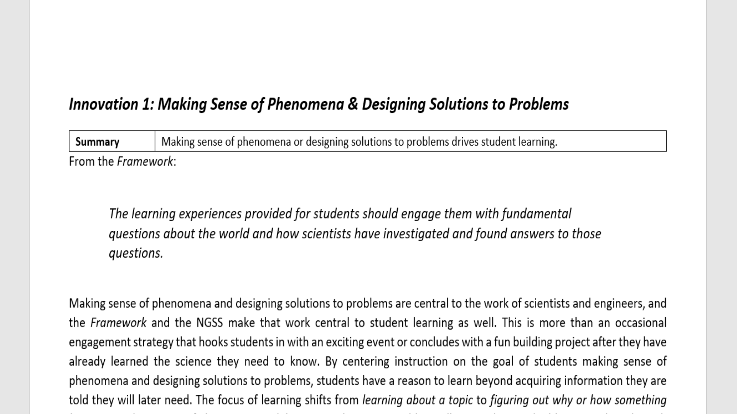
NGSS Innovation 1
Notes:
Facilitator Notes:
Participants will need their copy of Handout 1 – NGSS Innovations that they began to fill out earlier in the session.
Participants will need a copy of Handout 13 – Innovation 1.
Talking Points:
Let’s look at some more information of what NGSS designed programs should look less like and what they should look more like when considering the phenomena criterion.
Pull out your copy of the Innovation One handout.
Take a few minutes to read over this handout.
Turn to the Explaining Phenomena or Designing Solutions chart in the handout.
You probably see many the points from the left hand side in the textbooks you have in your classroom right now.
As you dig through instructional materials programs in the next two sessions, you will be searching for evidence of the points on the right hand side. These are all of the things we are looked for in the instructional materials programs in the prescreen. If a lot of the ideas from the right column appeared in the instructional materials, there was at least some evidence of NGSS design.
If a lot of the ideas from the left column appear in the instructional materials, there is some evidence of the materials not being completely designed for the NGSS.
Take a few minutes to go back to your NGSS Innovations handout and add in any additional thoughts in the second row of page two in the handout. Discuss your thoughts with your group. Especially focus on any new ideas about what you would look for as evidence that this NGSS Innovation is present in instructional materials.
[Note to facilitator: It may be helpful to have a whole group share out after individual teams have completed their discussions.]

Slide 67
Prescreen – Criterion #2
Three Dimensions:
Students develop and use grade-appropriate elements of the science and engineering practices (SEPs), disciplinary core ideas (DCIs), and crosscutting concepts (CCCs), which are deliberately selected to aid student sense-making of phenomena or designing of solutions across the learning sequences and units of the program.
Notes:
Facilitator Notes:
This slide explains the second prescreen criteria.
Build on the conversations that you had earlier this session about the three dimensions.
Talking Points:
The second criterion specifically and only focuses on whether or not each of the three dimensions are present in the materials. This is extremely similar to the evidence you looked in the immersion activity.
Take a minute to read the criterion on the slide.
Note that the second half of the criterion where it says that the elements for all three dimensions should be “deliberately selected to aid sense-making of phenomena or designing solutions.” It is extremely important that the elements that chosen for a lesson are selected for a purpose and are not random. The elements should always help students make sense of the phenomenon or to design a solution to a problem for the entire learning sequence.

Slide 68
Prescreen – Criterion #3
Integrating the Three Dimensions for Instruction and Assessment:
The instructional materials program requires student performances that integrate elements of the SEPs, CCCs, and DCIs to make sense of phenomena or design solutions to problems, and the learning sequence elicits student artifacts that show direct, observable evidence of three-dimensional learning.
Notes:
Facilitator Notes:
This slide explains the third prescreen criteria.
Build on the conversations that you had earlier this session about the three dimensions.
Talking Points:
The second criterion specifically and only focuses on whether or not each of the three dimensions are present in the materials. The third criterion focuses on whether the three dimensions are integrated for instruction and assessment.
Take a minute to read the criterion on the slide.

Slide 69
NGSS Innovation 2
Crosscutting
Concepts
Core Ideas
Practices
Notes:
Talking Points:
The previous criterion looked for evidence to see if the three dimensions were present.
However, the three dimensions need to work together, and they should not be taught in isolation. In instruction and assessment, when students makes sense of phenomena or design solutions to problems, their performances should integrate elements of all three dimensions.
The standards are written as three-dimensional performance expectations and this was both intentional and significant, as it signals that three-dimensional performances should be reflected in the learning experiences in instructional materials.
Therefore, it is not enough to see just the presence of the practices, or crosscutting concepts, or core ideas in instructional materials. There needs to be evidence that all three of these are purposefully integrated in student performances for both instruction and assessment.

Slide 70
NGSS Innovation 2
NGSS Innovation | How would you describe this innovation? | What would you look for as evidence that this NGSS Innovation is present in instructional materials?
Three Dimensional Learning
Notes:
Facilitator Notes:
Participants will need their copy of Handout 1 – NGSS Innovations that they began to fill out earlier in the session.
Talking Points:
Let’s go back to our NGSS Innovations handout.
Turn to page 2 in the handout.
How has your description of the second NGSS Innovation changed? Take a few minutes to talk to your group and come up with a working group description for three dimensional learning. Write your new description of this innovation in the table. [Note to facilitator: Click for animation.]
Based on what you have learned about three dimensional learning in the immersion activity and through our discussion, what would look for as evidence that this NGSS innovation is present in instructional materials? Discuss your thoughts with your group and then write your thoughts down in the table. [Note to facilitator: Click for animation.]

Slide 71
NGSS Innovation 2
Notes:
Facilitator Notes:
Participants will need a copy of Handout 14 – Innovation Two.
Talking Points:
Let’s look at some statements of what NGSS designed programs should look less like and what they should look more like when considering the two three-dimensional learning criteria.
Pull out your copy of the copy of the Innovation Two handout.
Take a few minutes to read over this handout.
Turn to the Three Dimensional Learning table in the handout.
As you dig through instructional materials programs in the next two sessions, you will be searching for evidence of the points on the right hand side. These are all of the things we are looked for in the instructional materials programs in the prescreen. If a lot of the ideas from the right column appeared in the instructional materials, there was at least some evidence of NGSS design.
If a lot of the ideas from the left column appear in the instructional materials, there is some evidence of the materials not being completely designed for the NGSS.
Take a few minutes to go back to your NGSS Innovations handout and add in any additional thoughts in the third row of page two in the handout. Discuss your thoughts with your group. Especially focus on any new ideas about what you would look for as evidence that this NGSS Innovation is present in instructional materials.
Note to facilitator: It may be helpful to have a whole group share out after individual teams have completed their discussions.

Slide 72
Prescreen Criteria
Making Sense of Phenomena and Designing Solutions to Problems
Three Dimensions
Integrating the Three Dimensions for Instruction and Assessment
Notes:
Talking Points:
The leadership team used the tool associated with each of the three prescreen criteria to look for evidence of that criteria in all of the instructional materials programs that were submitted.
The programs that showed evidence for this criteria in the tools, show that there is some promise of NGSS design. These programs will be further evaluated to see if there is NGSS design at the unit level and at the entire program level.

Slide 73
Next Steps?
Session Two: Unit Evaluation (PEEC Phase 2)
Session Three: Program Evaluation (PEEC Phase 3)
Notes:
Facilitator Notes:
Make sure participants understand what they will be doing in the next two sessions.
Talking Points:
You will learn about and apply the unit evaluation process from the second phase of PEEC during our next session. The programs that pass that evaluation phase will go through to the final evaluation round. In Session 3, you will learn about and use the program evaluation process, which is the final part of the PEEC process.
Do you have any questions about the prescreen criteria, what the leadership team did during the prescreen, or what you will be doing in the next two sessions?

